Slide 1
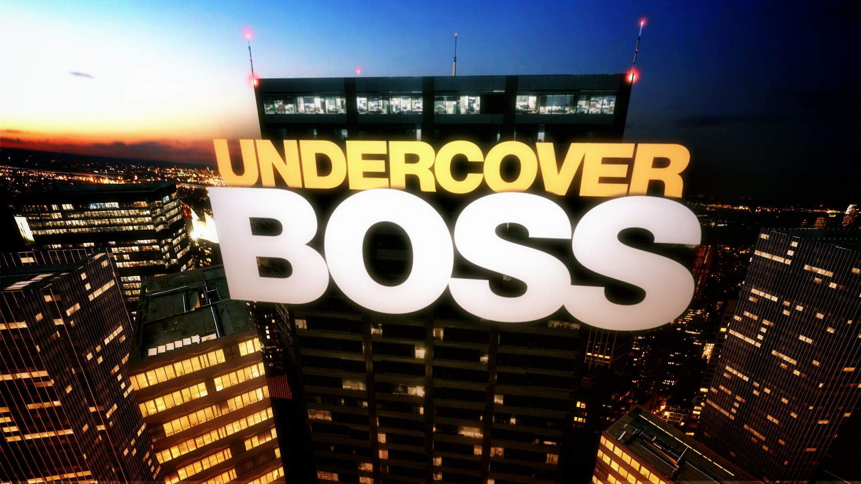
Management Group 52
黃澤熙 0440211
謝劉舜 0440

Slide 2
Dilemma
目錄
Stakeholders
Alternatives and consequences
Contents

Slide 3

Dilemma
On the one hand
boss想要了解公司的运作，希望能够更好地管理公司，同时员工在不知情的情况下会表现出最真实的状态
On the other
这种行为类似于对员工的监视，可能会侵犯员工的隐私权，失去员工的信任，同时在节目播放之后可能会对员工未来的工作以及家庭造成影响

Slide 4
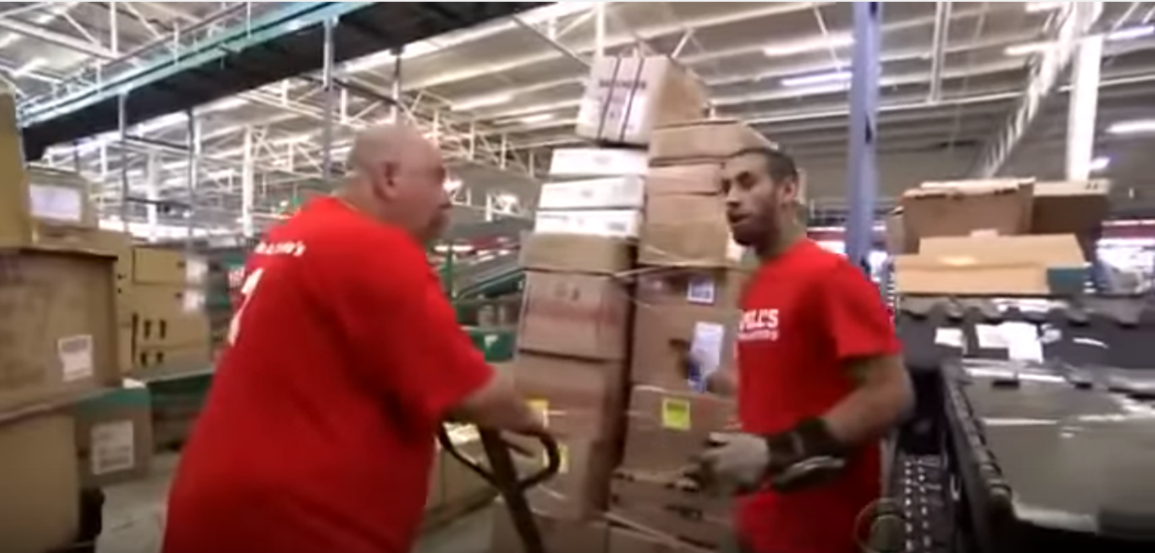
Stakeholder: Boss
Advantages
The boss can know what first-line employees really think and really face, experiencing the same working condition. In the view of controlling, being an undercover boss is good opportunity for personal observation, which is the source of first-hand knowledge.
Figure. Undercover boss (left) at Modell's Sporting Goods is being trained how to use the loading rider by one of his first-line employees (right). He admitted that he didn’t imagine their work was so Labor-intensive and risky before he did it himself.

Slide 5
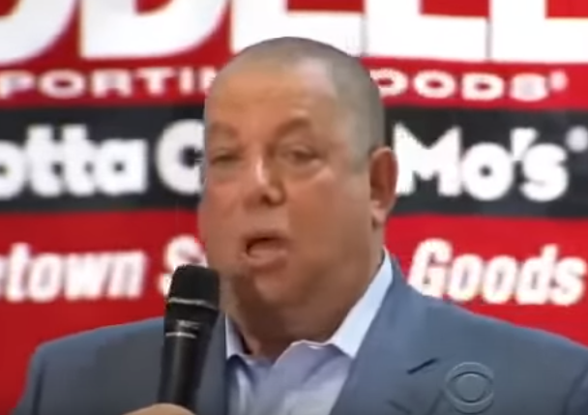
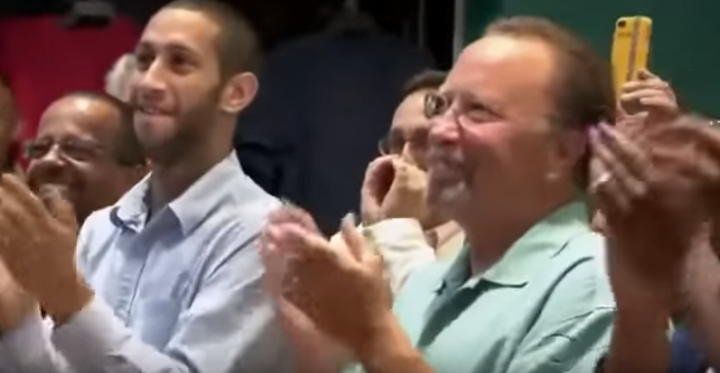
Stakeholder: Boss
Advantages
Figure. The boss shared his experience and feelings with his employees and received great applaud from them.
Sharing their first-hand experience can make the employees feel that the boss is no more distant and cares about them, which earns the boss good reputation support.
The organization can enjoy more popularity if the boss performed well in the TV series.

Slide 6
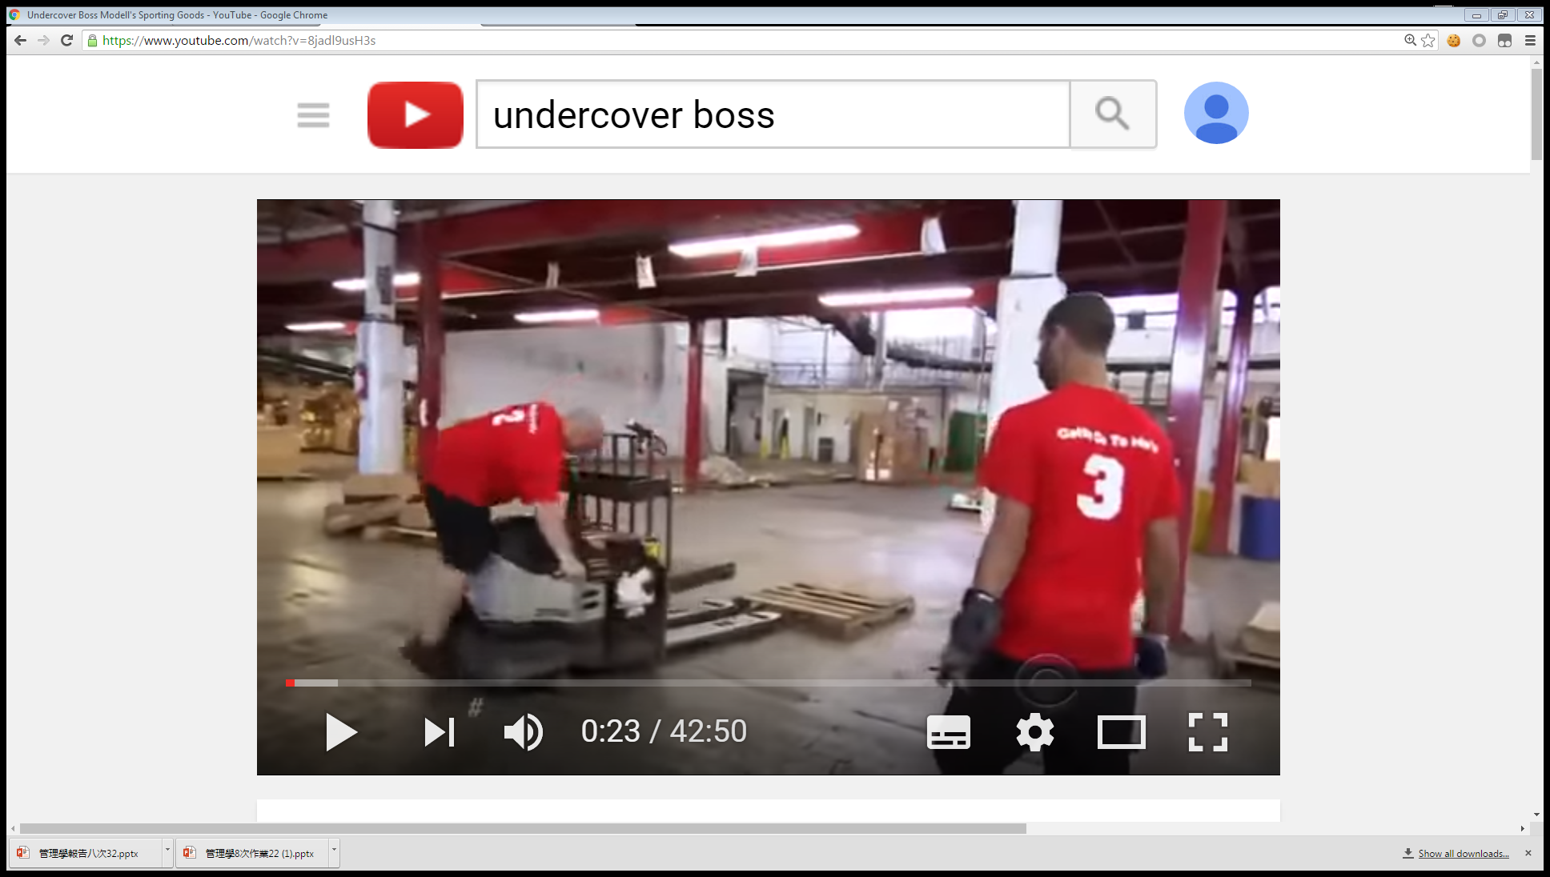
Stakeholder: Boss
Disadvantages
May be grudged by some of employees because of the indecent way of surveillance. Further consequences includes distrust in workplace.
May have safety concern since the boss is in fact not well trained to be first-line worker.
Figure. The boss (left) nearly hurt himself when riding the loading rider.

Slide 7
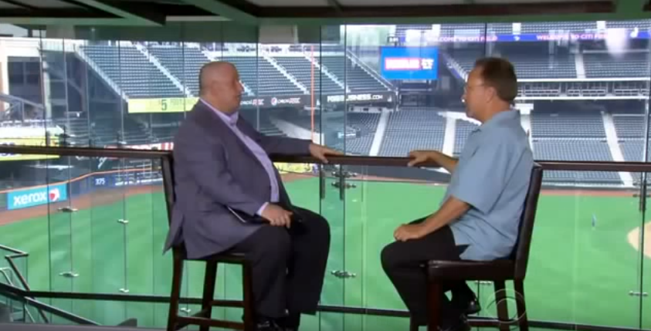
Stakeholder: Employees
Advantages
Those who work hard and really care for the organization recognized by the undercover boss would possibly get promoted with other rewards.
Figure. The manger (right) who supervised the store the undercover boss (left) was working for got promoted because of his dedication to his work.

Slide 8
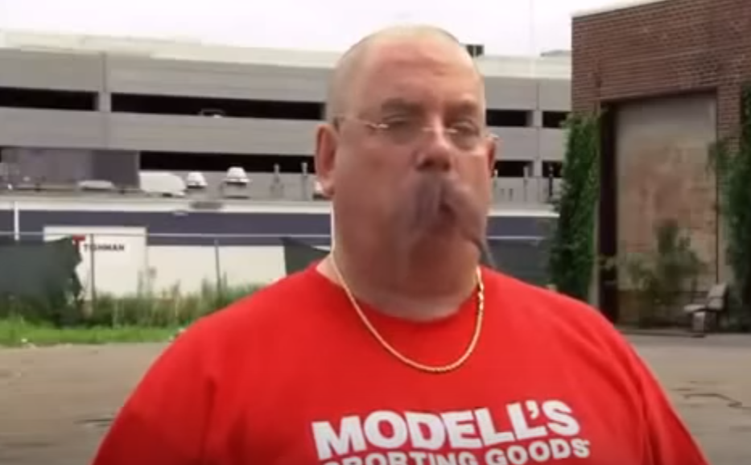
Stakeholder: Employees
Advantages
After the boss suffered from their working condition, the boss would likely to change the policies and reward systems to solve their problems so that they could enjoy better workplace.
Figure. “I will let my company to become some place that the people feel good about come to work at, feeling that if they work hard, they will be recognized and rewarded. Right now it's not the case. And I feel horrible.” said the boss after he learned employees’ trouble.

Slide 9
Stakeholder: Employees
Disadvantages
Those who failed to fulfill their responsibilities got caught may lose their jobs as well as their faces if captured by cameras and broadcast.
Employees may feel they lose their privacy at work and can’t work as normal.
They may also worry about the recurrence about the undercover boss and become sensitive at workplace.

Slide 10
Stakeholder: Employees’ families
Advantages
Disadvantages
They may have access to the real-life working condition of their families through the television.
They may feel proud if their relatives captured by the camera showing good behaviors at work.
If their families who were captured by the camera showing inappropriate behaviors at work, they may be laughed at by their friends and colleagues who happened to watch this series.

Slide 11



Alternatives and consequences
在宣布结果时宣布自己被员工所打动的部分以及自己即将采取的改善员工状况的措施，避免对员工的“点名批评”
让员工感受到自己的同理心，提升员工的士气，同时保留工作不当的员工的颜面
表达清楚这次活动的目的，说明这是为了让公司拥有更好的发展而不是更好地监视员工
避免员工产生不满与反抗心理
对于在过程中发现表现不佳的员工，私下里进行沟通，解决问题
一方面顾全员工的颜面，另一方面保证问题确实的得到了解决
在节目播出之前对节目内容进行审核，只有选择地播出不涉及员工隐私以及员工不良行为的部分
维护员工的隐私权同时维护公司的正面形象

Slide 12
Alternatives and consequences
Add your title
优点：确保员工是接受boss这种方式的
缺点：员工可能会拒绝，或者做好准备，这样boss没办法了解真实的状况
在招募员工时，询问员工是否接受
这种方式

Slide 13
Alternatives and consequences
Add your title
优点：确保避免了侵犯员工隐私的问题
缺点：员工有可能不会反应真实状况，boss不一定会满意
通过匿名问卷的形式，让员工自己反应
公司的现状和问题

Slide 14
Thank You

