Slide 1
Empathy Experiment
Final Report
Mute for a day &
Visual Impairment Simulation
Psychology and Modern Life, Spring 2016
Group 9
胡佳萱, Hannah, 103011172
黃澤熙, Eitima, T16313528
艾怡華, Eva, 103062181
城戶龍太, Kido, 103070039

Slide 2
Empathy Experiment, Final Report: Outline
Forms and Meeting Photos
Planning vs Reality
Process of the Exercise
Problems and Solutions
Reflections
Ideas for Social Improvement

Slide 3
Forms & Meeting Photos

Slide 4
Forms & Meeting Photos: Preliminary form

Slide 5
Forms & Meeting Photos: Planning form

Slide 6
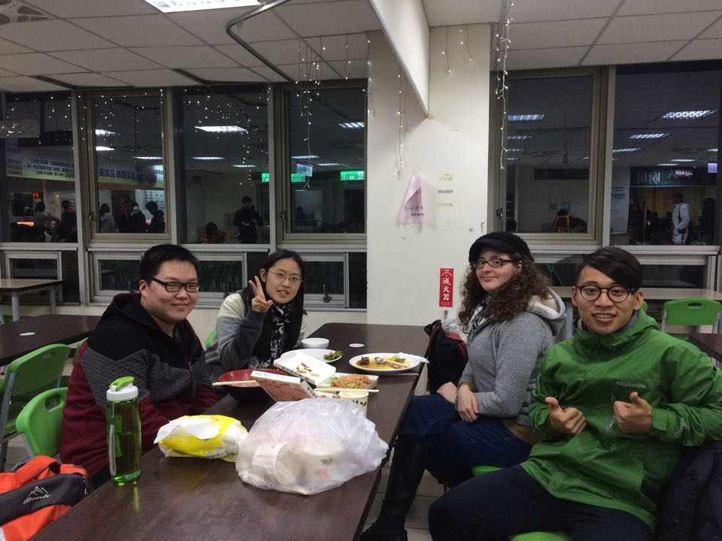
Forms & Meeting Photos: Meeting Photos
Time: 18.30 Feb.25th
Place: 3rd floor of Fengyun Building
(Other group photos seemed to be lost because data loss of both Hannah’s and Eva’s cellphone. Please refer to the previous uploads of forms for them)

Slide 7
Planning vs Reality

Slide 8
Planning vs. Reality: Outline
Purpose
Objectives
Place
Difficulties
Original Schedule
Actual Progress
Resources
Group Work

Slide 9
Planning vs. Reality: Purpose
For the trip to Neiwan:
We wanted to understand how being mute affected interactions with other people in daily life.
We wanted to see in which ways this impairment changed the daily routine of people who suffer it.
We wanted to understand how daily, mundane things for us might be perceived by people with this impairment
We wanted to understand how this impairment affected communication when being together with a small group of people

Slide 10
Planning vs. Reality: Purpose
For the trip Visual Impairment Simulation:
We wanted to understand the effects of a partial disability (not fully considered a disability) can have on the eyesight; something we take for granted.
We wanted to experience the world with two disabilities, in this particular case, muteness and eyesight problems; since these 2 senses are definitely the senses we rely on the most to communicate with the outer world and process information coming from it.

Slide 11
Planning vs. Reality: Objectives
In order to have some guidelines for our exercise and force us to interact with more people, we set ourselves some objectives.
Eat at least 1 traditional dish of the place we were going to visit
Visit at least 4 touristic spots
Buy at least 2 souvenirs per person

Slide 12
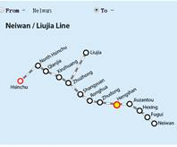
Planning vs. Reality: Place
We wanted to be in an environment where we would be forced to interact with a maximum of people; and thus chose Neiwan, as there is a lot of stores and stands, and offered a perfect opportunity to us.
We chose Neiwan as our destination because it’s one of the few touristic spots (i.e., with a lot of stands). It’s not too far from Hsinchu and it’s a place none of us had visited before. We didn’t look up directions prior to making our trip to increase the difficulty of the exercise.

Slide 13
Planning vs. Reality: Difficulties
Scheduling was a very hard thing to do, since we needed an entire day for the Neiwan trip, and all of us had very busy schedules and plans. We scheduled the day May 7th for our activities with about 4 weeks anticipation.
Because of a personal issue (Kido went to the airport to say goodbye to his brother), we had to remake the schedule we had originally made and hurry up to complete our objectives on time.

Slide 14
Planning vs. Reality: Original Plan
Our original plan included the ideas below:
Trip to Neiwan as mutes, unable to understand chinese
Visit a doctor as a mute
Watch a movie with visual impairments
Practice different sports with different physical disabilities

Slide 15
Planning vs. Reality: Actual Plan
The trip to Neiwan as mutes took place on May 7th, 2016.
Watching the movie wit visual impairments took place on May 18th 2016, 3:30 to 6:30, at NTHU’s library.
The trip to the doctor was canceled due to not having real health issues to justify visiting a doctor.
Practicing different sports with different physical disabilities was canceled due to schedule conflicts and time limits.

Slide 16
Planning vs. Reality: Original Schedule
At first, we thought of staying one night at Neiwan and making the Neiwan trip last an entire weekend. The idea was that we would try to look for a place to sleep on the spot, and the penalty for not finding one on time would be sleeping on the streets or in a bench in a park.
Due to safety concerns and potentially high fees from the hotel, we shortened our trip to a single day. We agreed on a schedule and agreed to meet at 10:00 A.M. in the main gate.
The day before our trip, we agreed to meet 2 hours after the time we had originally planned as a personal issue ensued.

Slide 17
Planning vs. Reality: Original Schedule
HOUR | PROGRESS
9:00 | Meet at NTHU’s gate
9:30 | Arrival at Hsinchu’s train Station
11:00 | Arrival at Neiwan, eat early lunch
12:00 | Stroll the streets at Neiwan
1:00 | Search for 4 touristic sites and visit them
3:00 | Search and buy souvenirs
5:00 | Have dinner
6:00 | Take the train back to Hsinchu
7:30 | Arrival to Hsinchu’s main station
Our final schedule

Slide 18
Planning vs. Reality: Actual Progress
HOUR | PROGRESS
12:00 | Meet at NTHU’s gate
12:20 | Arrival at Hsinchu’s train Station
1:50 | Arrival at Neiwan, eat late lunch
2:20 | Stroll the streets at Neiwan (buy some souvenirs)
3:00 | Visit Drawbridge
4:10 | Visit Opera
4:50 | Search and buy souvenirs
5:10 | Visit Train station
5:40 | Visit Police Station
6:20 | Take the train back to Hsinchu
8:10 | Arrival to Hsinchu’s main station
Our actual progress

Slide 19
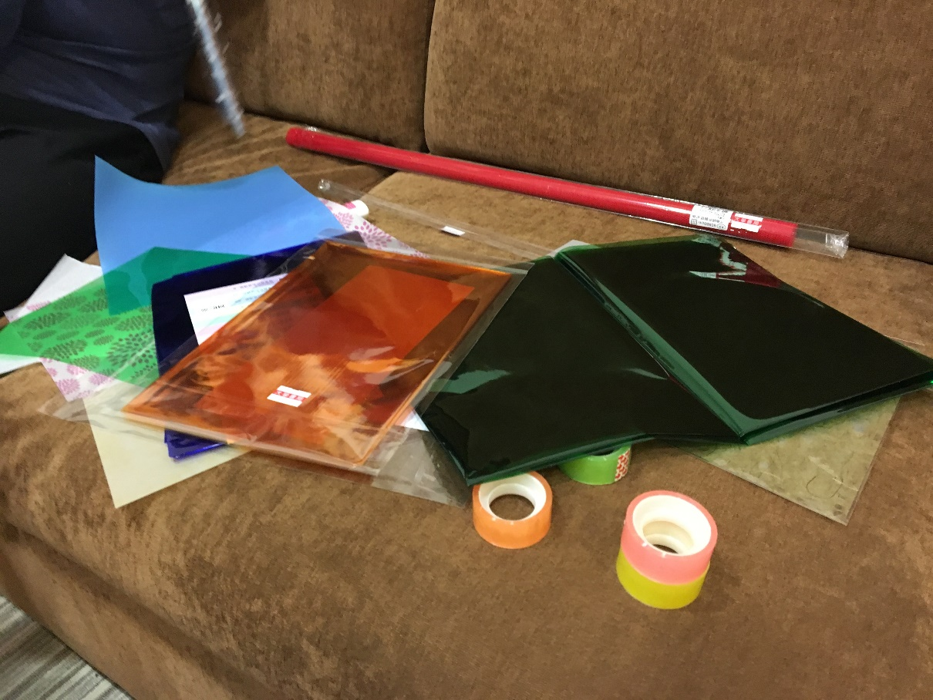
Planning vs. Reality: Resources
For the movie activity, we had to prepare our glasses. We bought different kinds of tapes, cellophane papers and small nets. We made our glasses on spot the same day we watched the movie.

Slide 20
Process

Slide 21
Process: Outline
Neiwan Trip
  Difficulties：mute (can’t speak) / don’t understand Chinese
  Traveling to Neiwan (by train)
  Eating around
  Visiting spots
  Purchasing souvenirs
  Returning Home
Watching A Movie
  Difficulties：mute (can’t hear) / color blind or with eye diseases
  Where and what
  Designing glasses shades
  Watching the movie

Slide 22
Process: Neiwan Trip, Schedule
NTHU main gate
Hsinchu Railway Station
Neiwan Railway Station
Neiwan bridge
Neiwan opera
Neiwan police station
Neiwan Railway Station
Hsinchu Railway Station
NTHU main gate

Slide 23
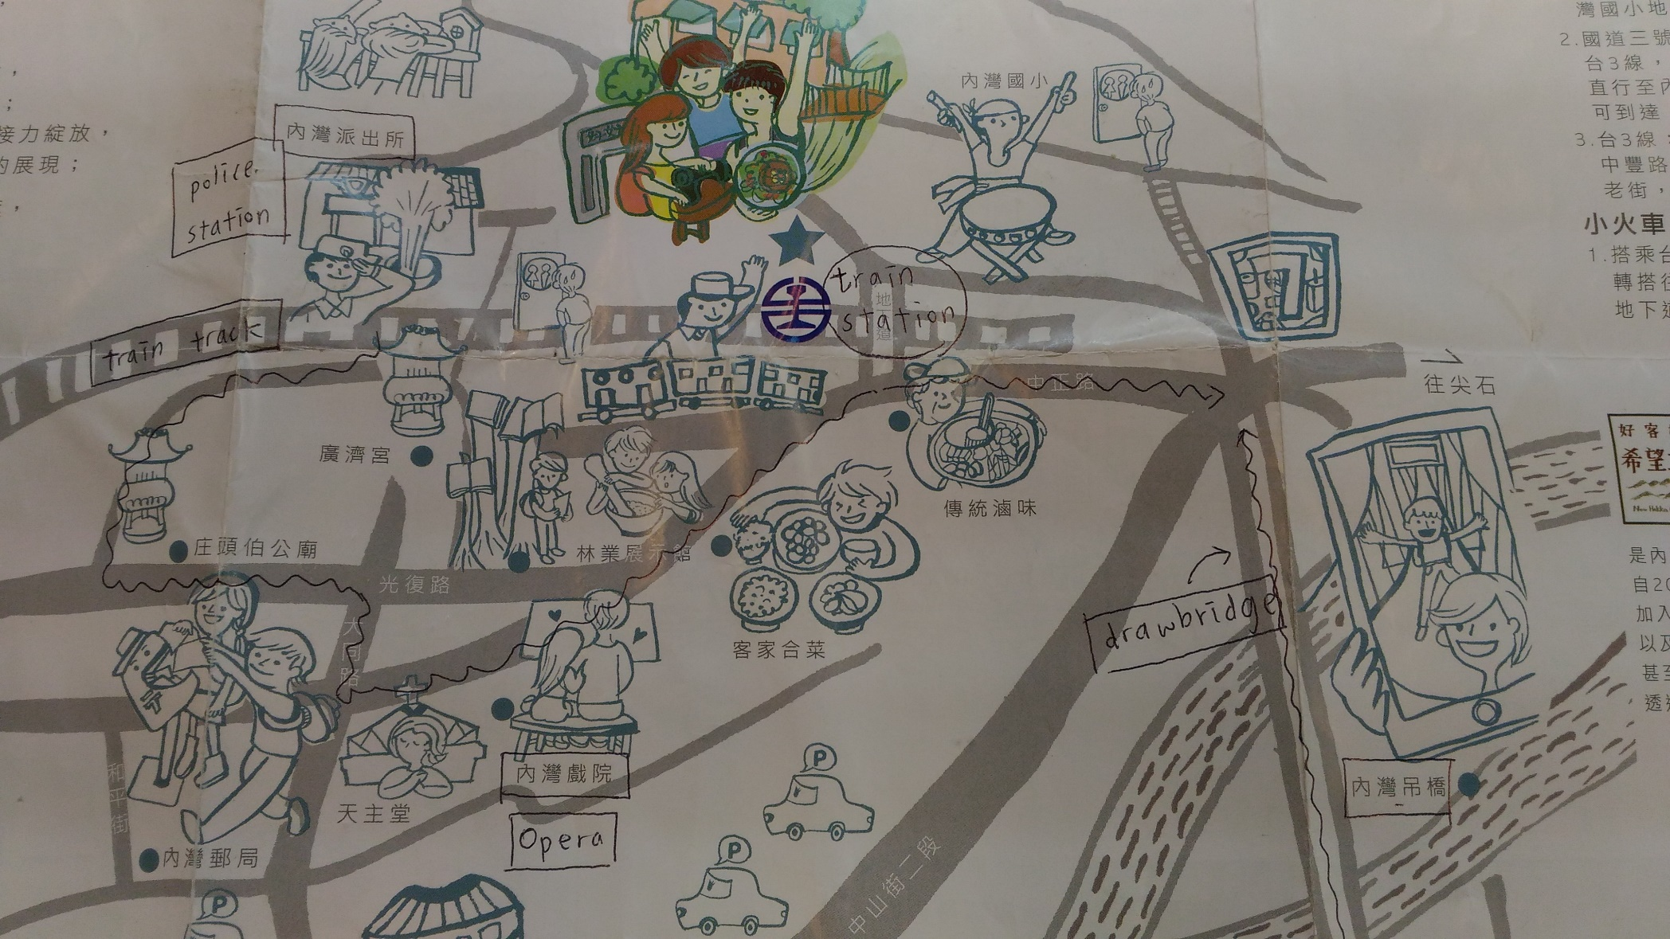
Process: Neiwan Trip, Route map
The map that we used

Slide 24
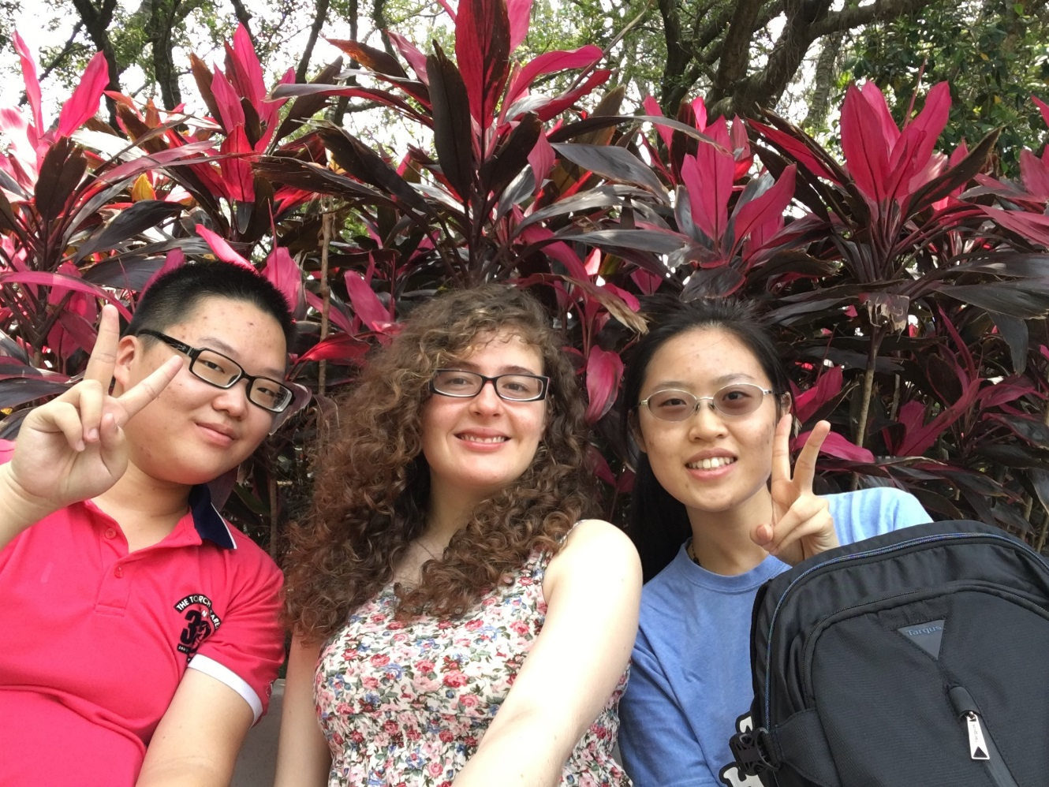
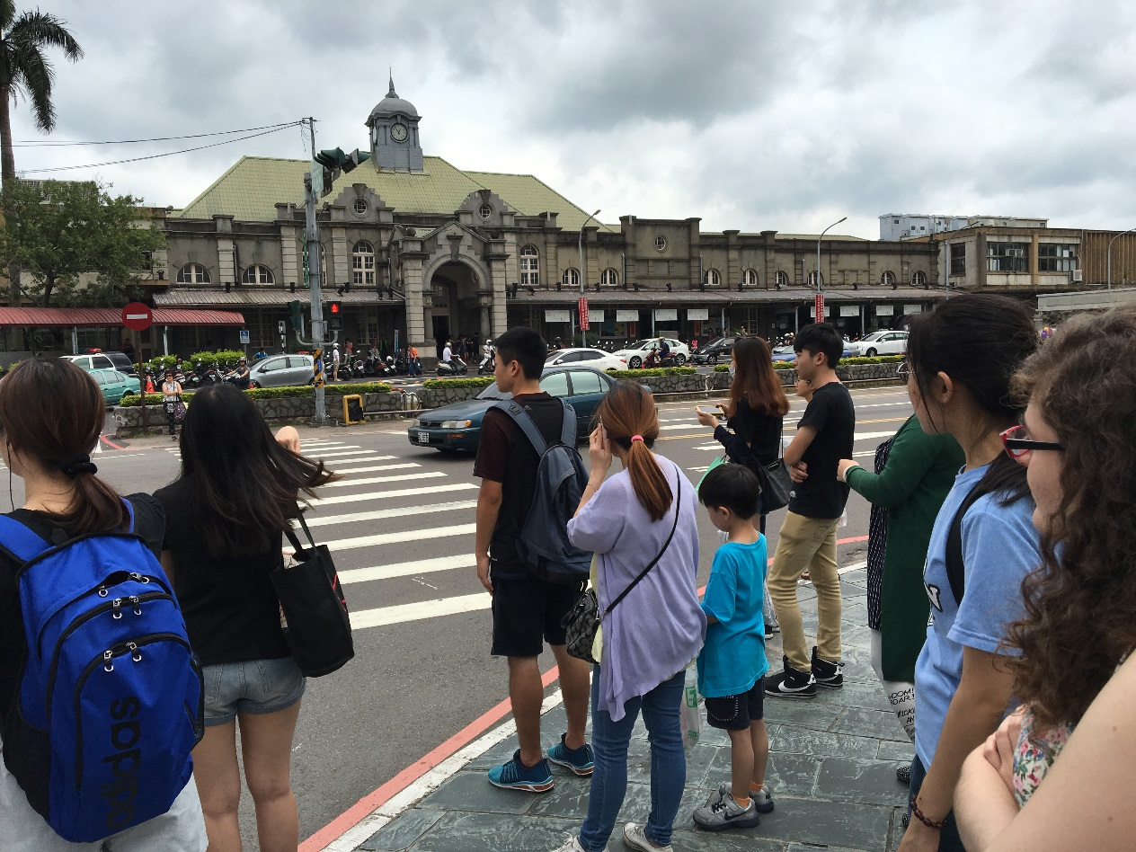
Process: Neiwan Trip, Traveling to Neiwan
Leave from NTHU main gate.
Arrive at Hsinchu Railway Station

Slide 25
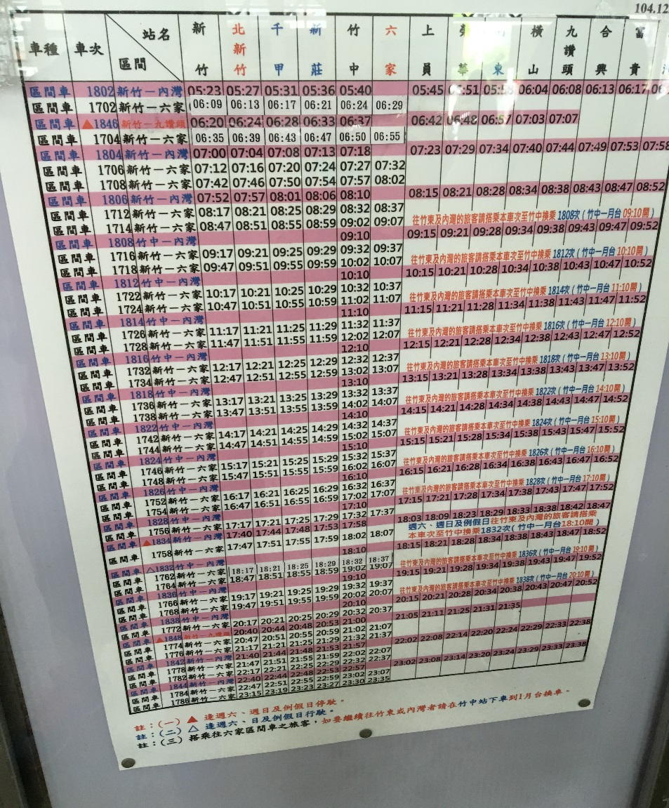
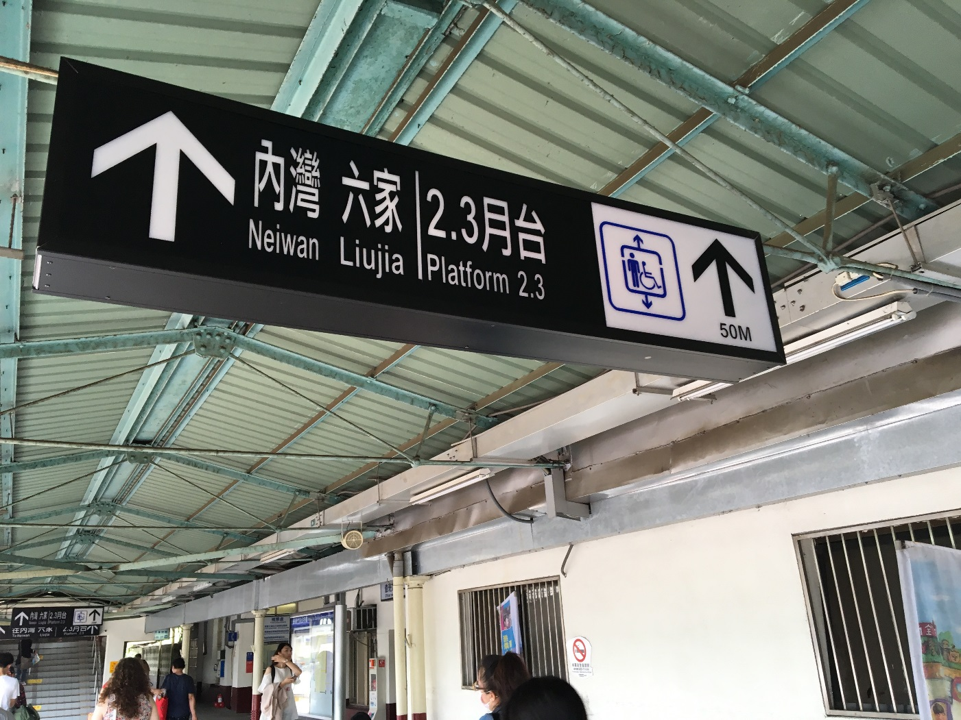
Process: Neiwan Trip, Traveling to Neiwan
Checking timetable.
Train to Neiwan

Slide 26
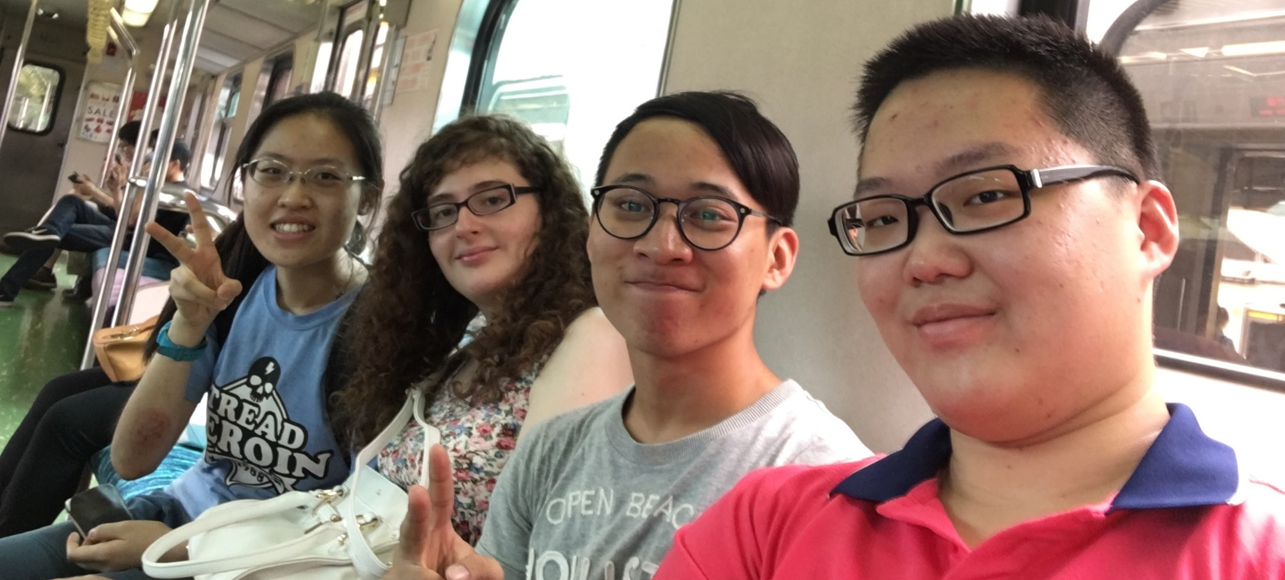
Process: Neiwan Trip, Traveling to Neiwan
On the train.

Slide 27
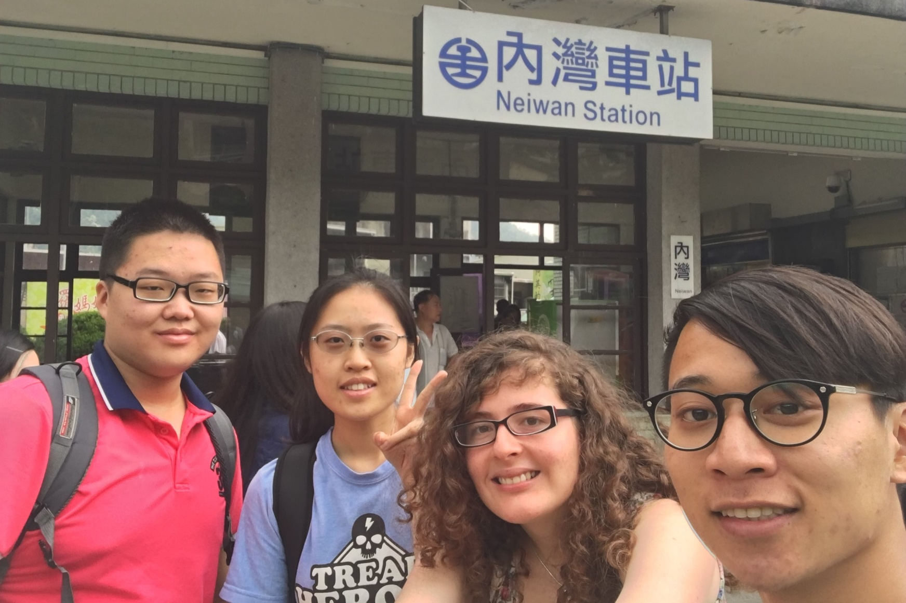
Process: Neiwan Trip, Traveling to Neiwan
Arrive at Neiwan

Slide 28
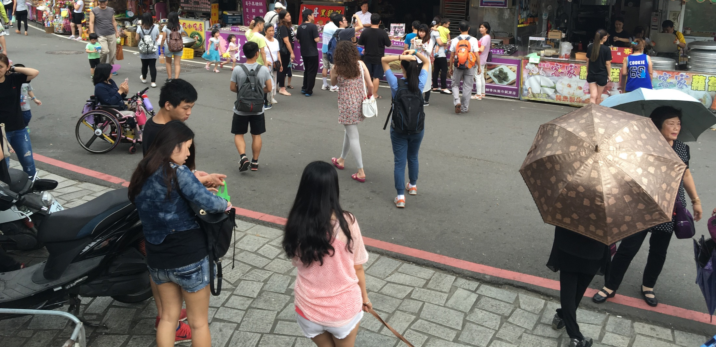
Process: Neiwan Trip, Eating around
First step in Neiwan

Slide 29
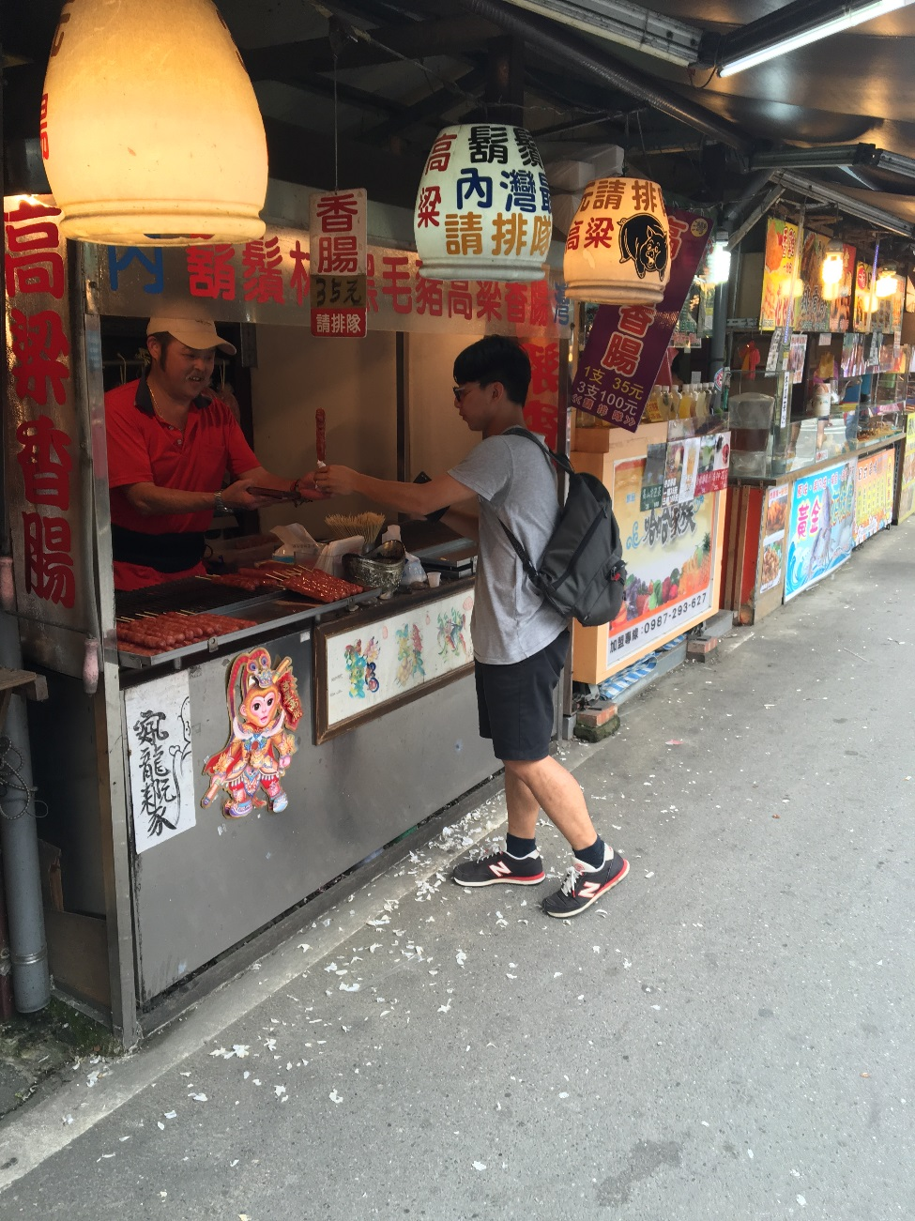
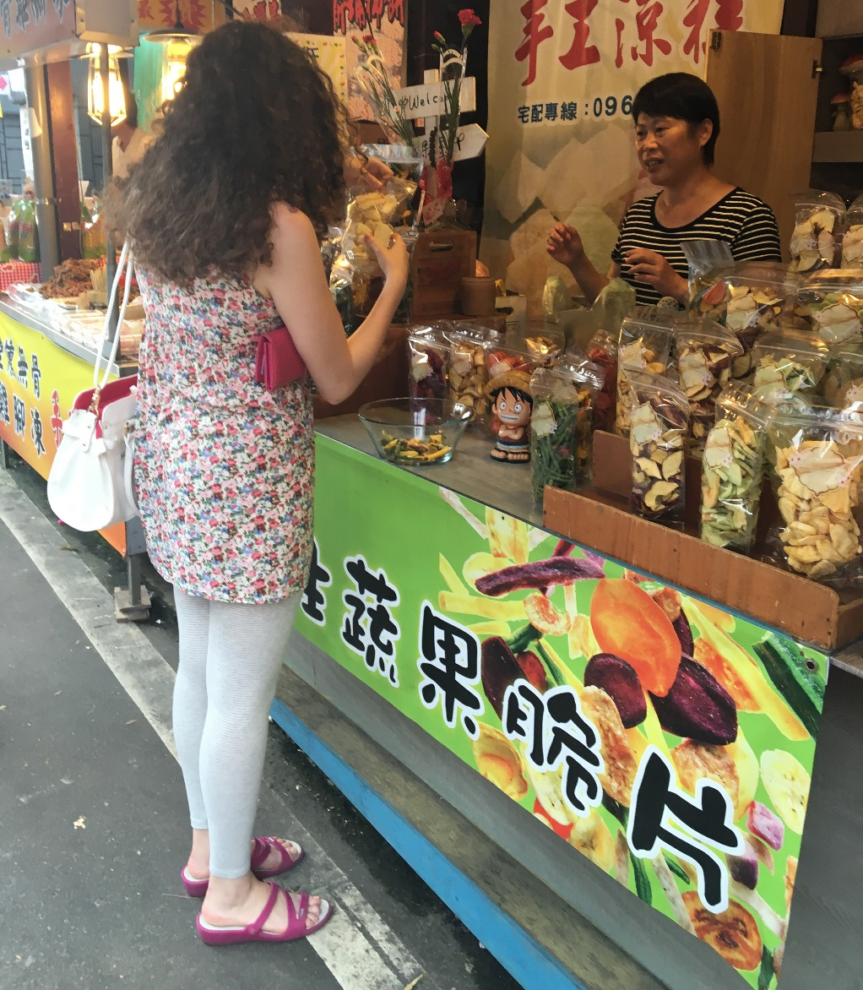
Process: Neiwan Trip, Eating around
Eva buying food
Kido buying food

Slide 30
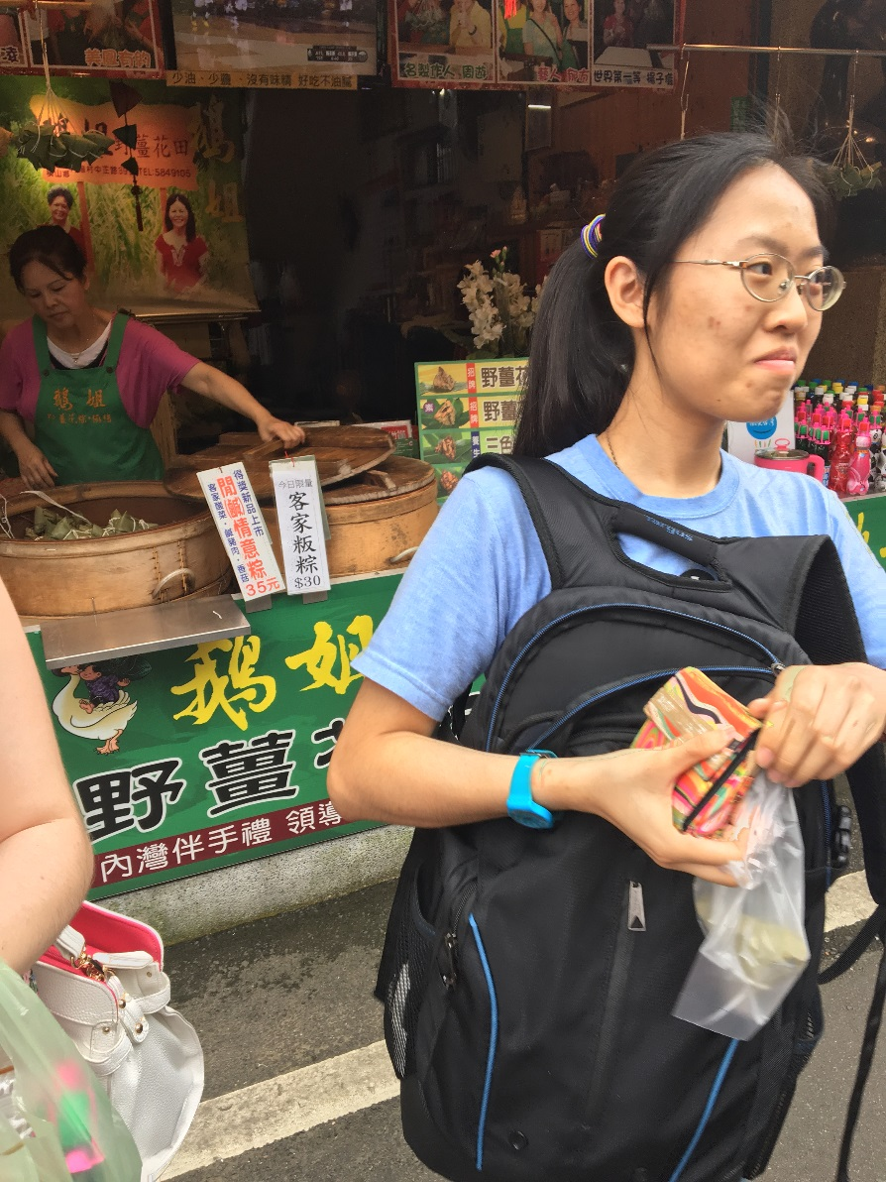
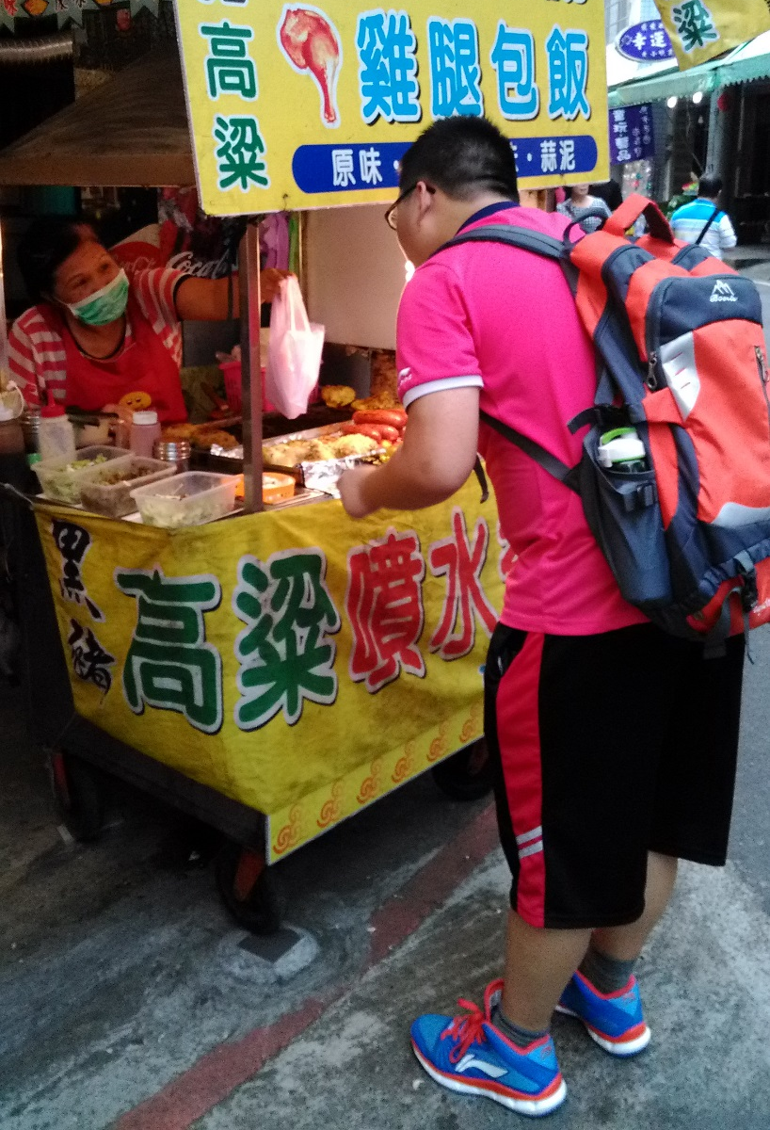
Process: Neiwan Trip, Eating around
Hannah just got it
Eitima buying food

Slide 31
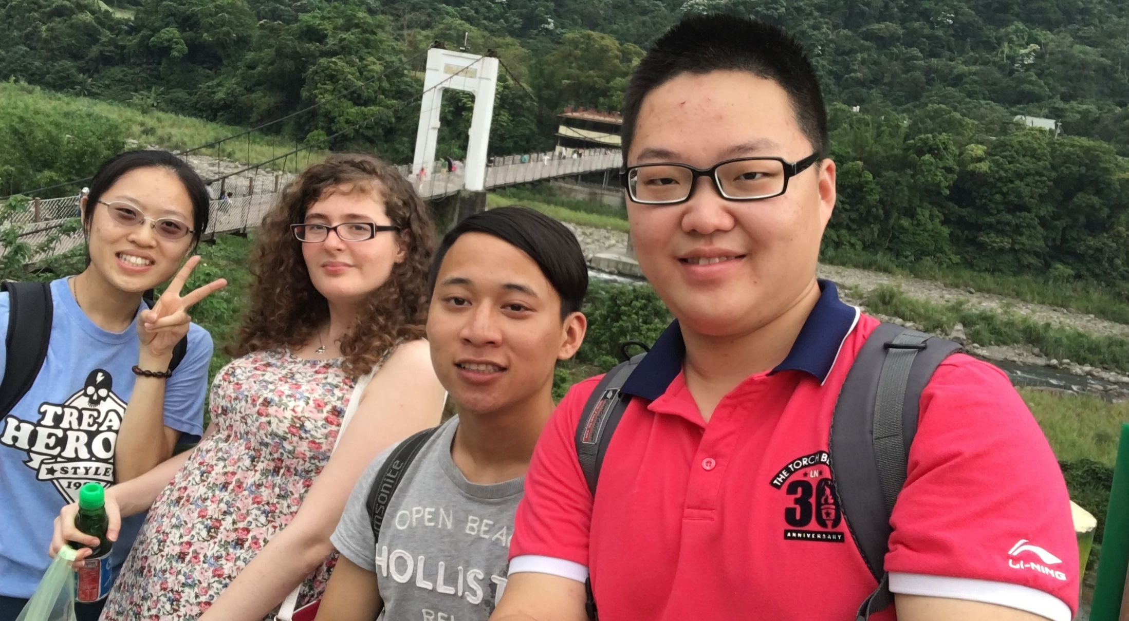
Process: Neiwan Trip, Visiting spots
Arrive at the Drawbridge

Slide 32
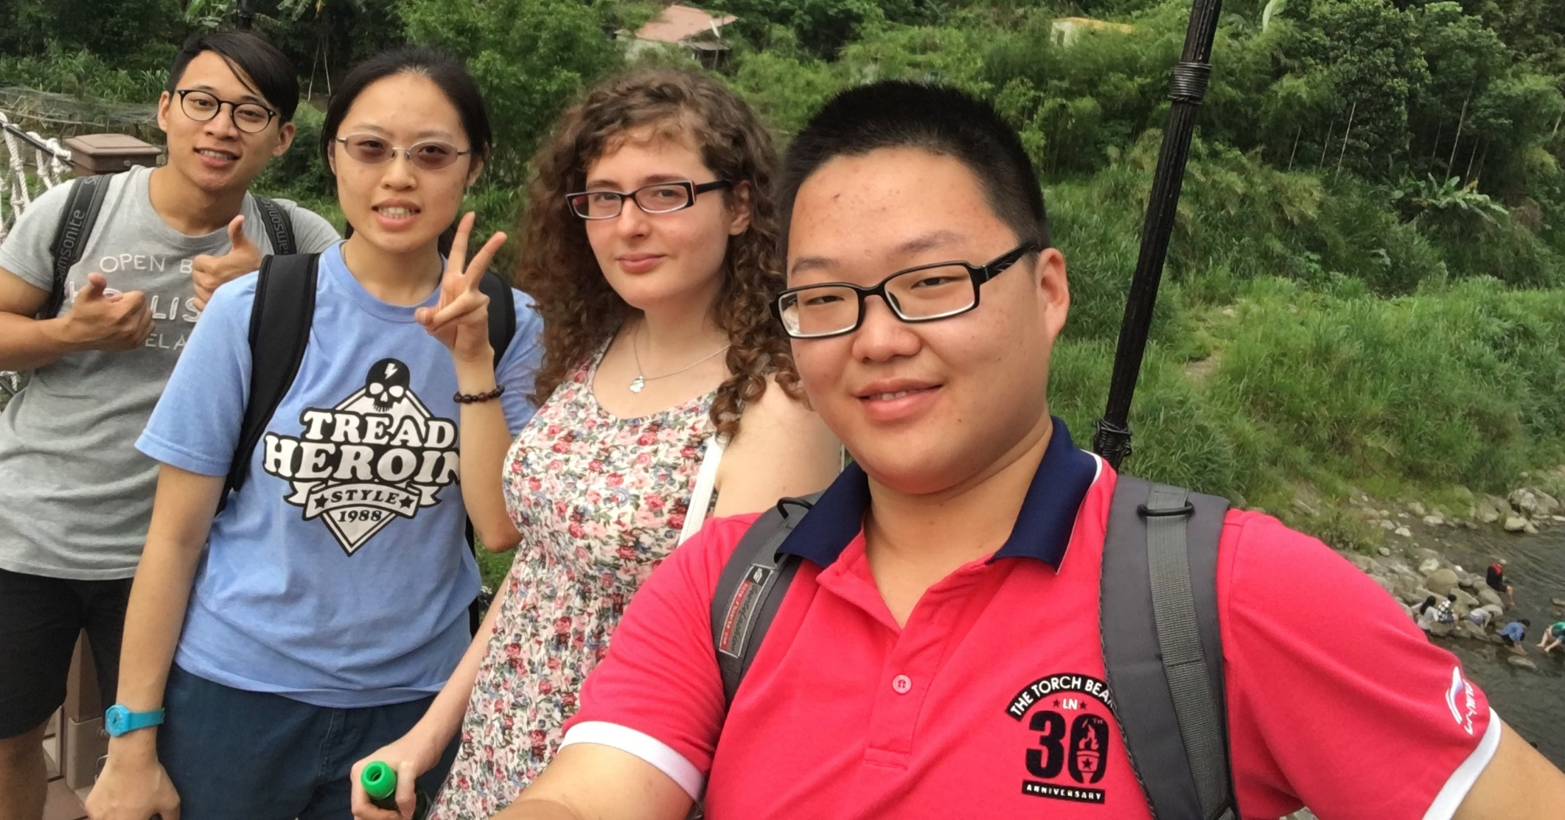
Process: Neiwan Trip, Visiting spots
On the Drawbridge

Slide 33
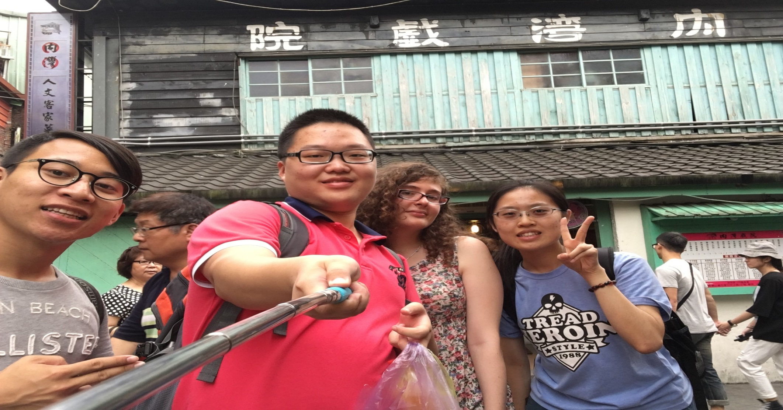
Process: Neiwan Trip, Visiting spots
Arrive at the Opera

Slide 34
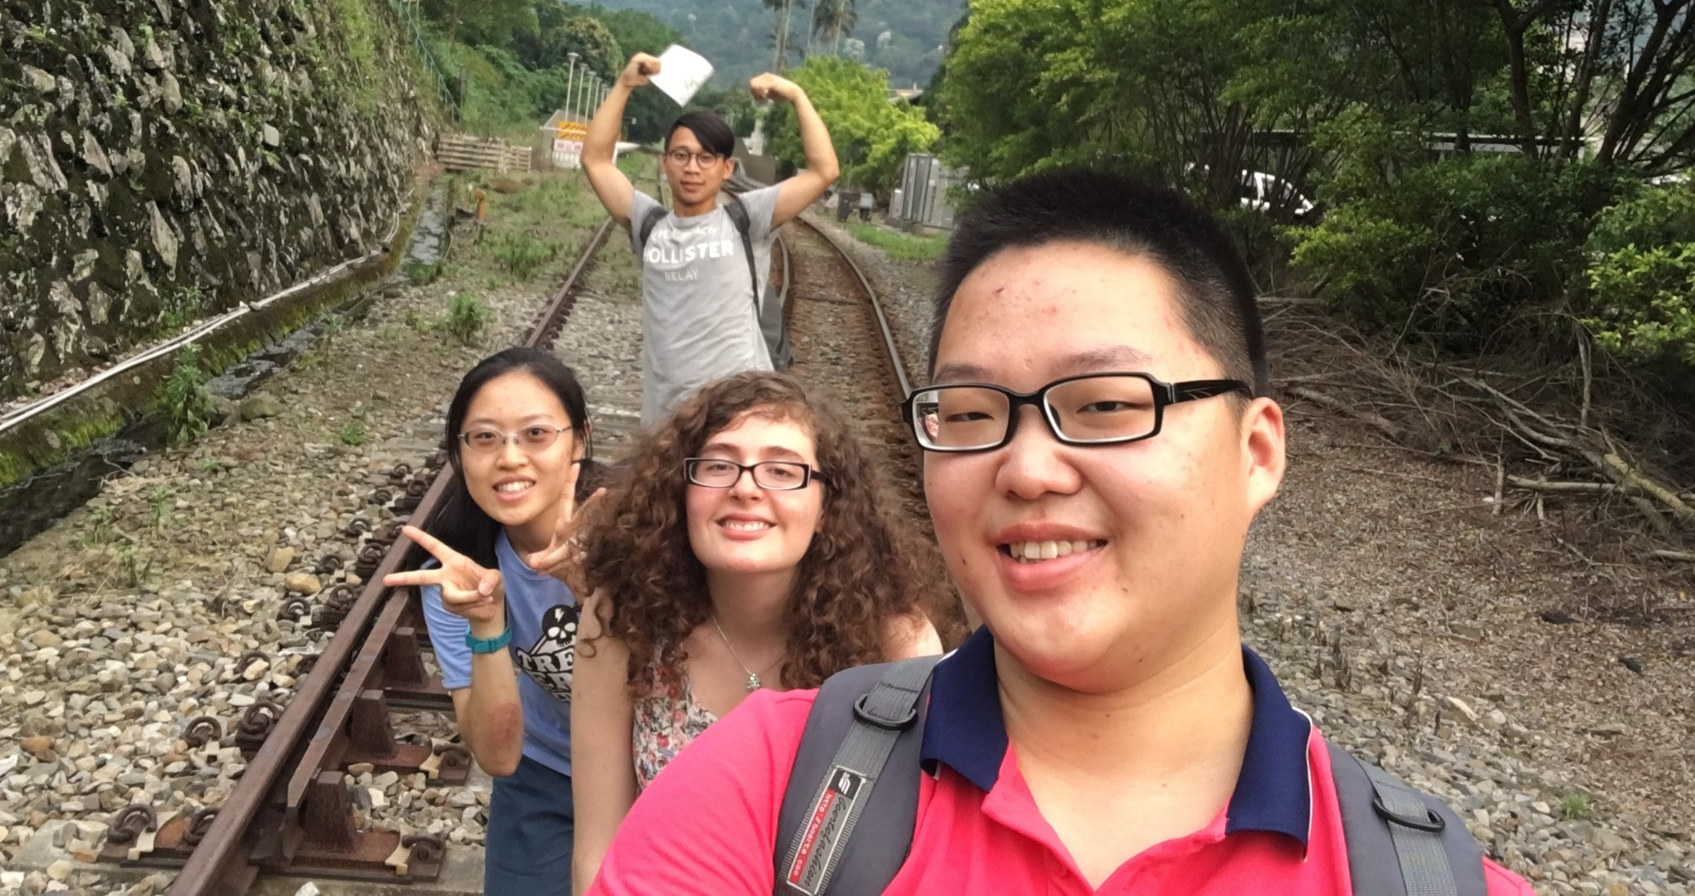
Process: Neiwan Trip, Visiting spots
On the train track

Slide 35
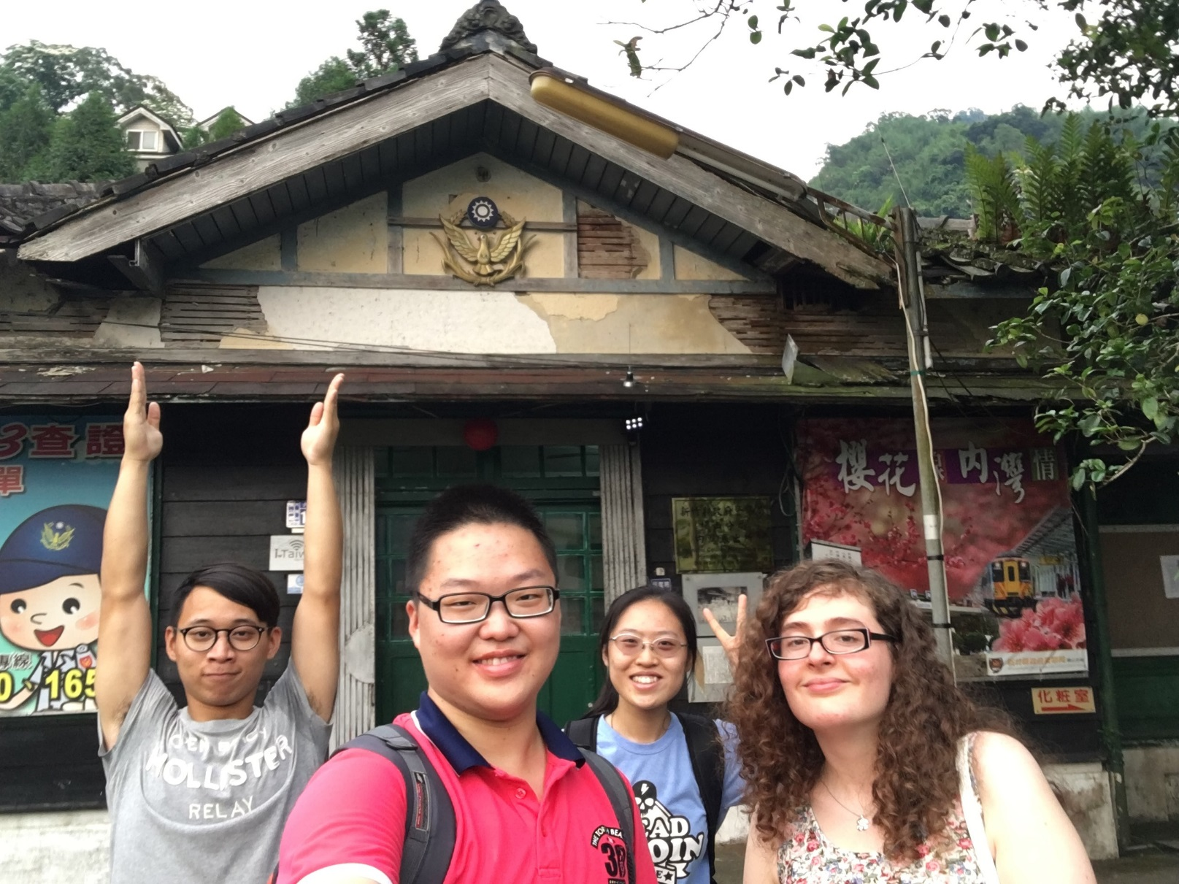
Process: Neiwan Trip, Visiting spots
In front of the police station

Slide 36
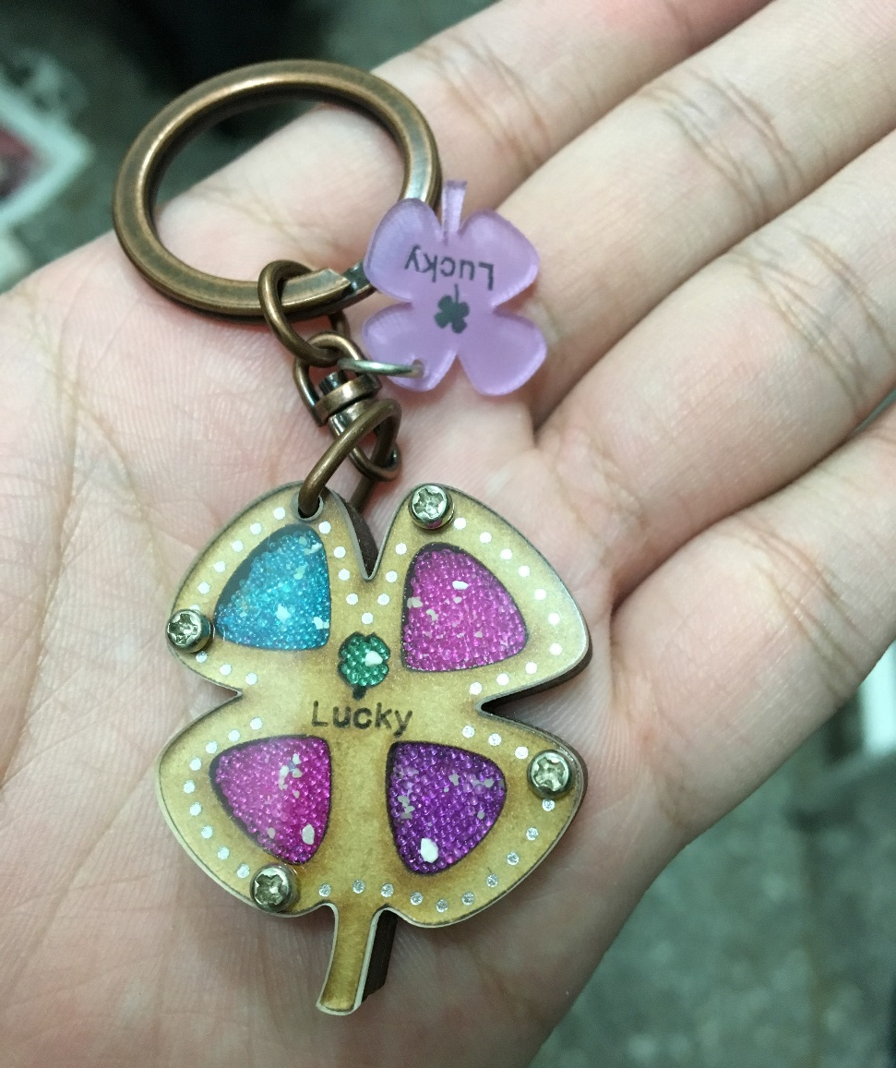
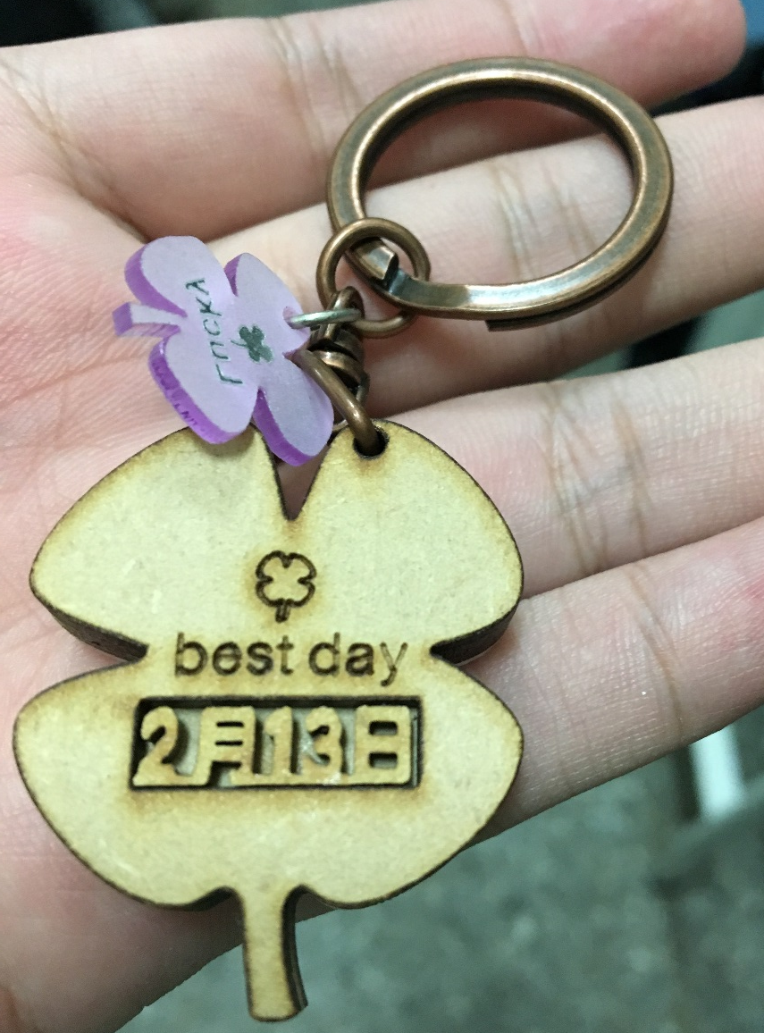
Process: Neiwan Trip, Purchasing souvenirs
Eitima’s Strap for mom

Slide 37
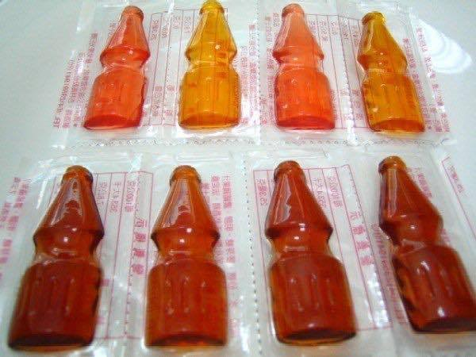
Process: Neiwan Trip, Purchasing souvenirs
Kido’s souvenir

Slide 38
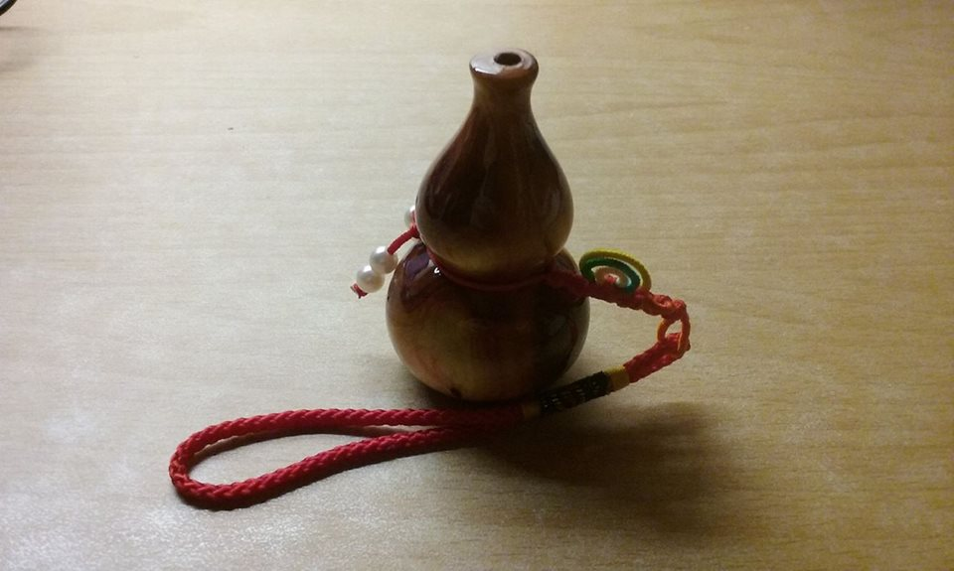
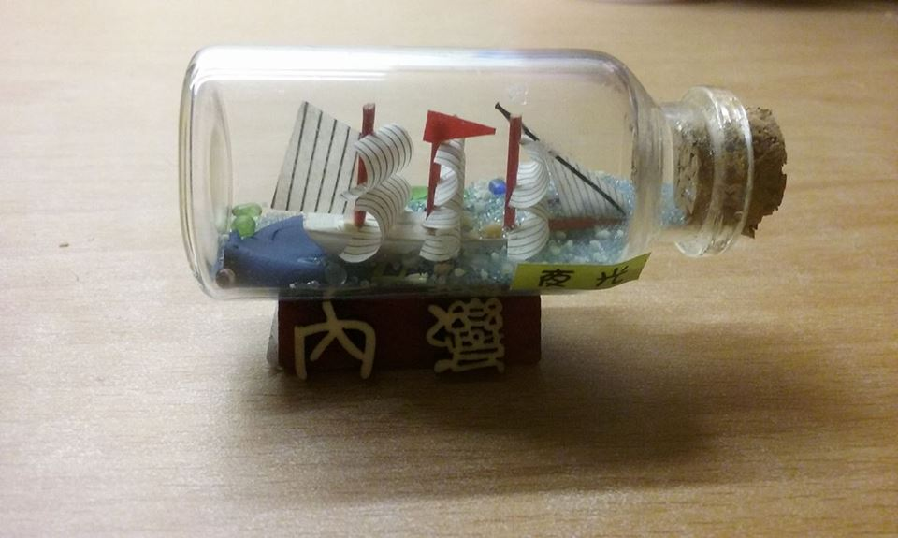
Process: Neiwan Trip, Purchasing souvenirs
Eva’s souvenirs
  Dried apples, dried bananas (to share between friends)
  Almond Cookies
  (to share between friends)
  Small boat in a bottle that lights up in the dark (for my sister)
  Small Taiwan wooden souvenir(for my mom)

Slide 39
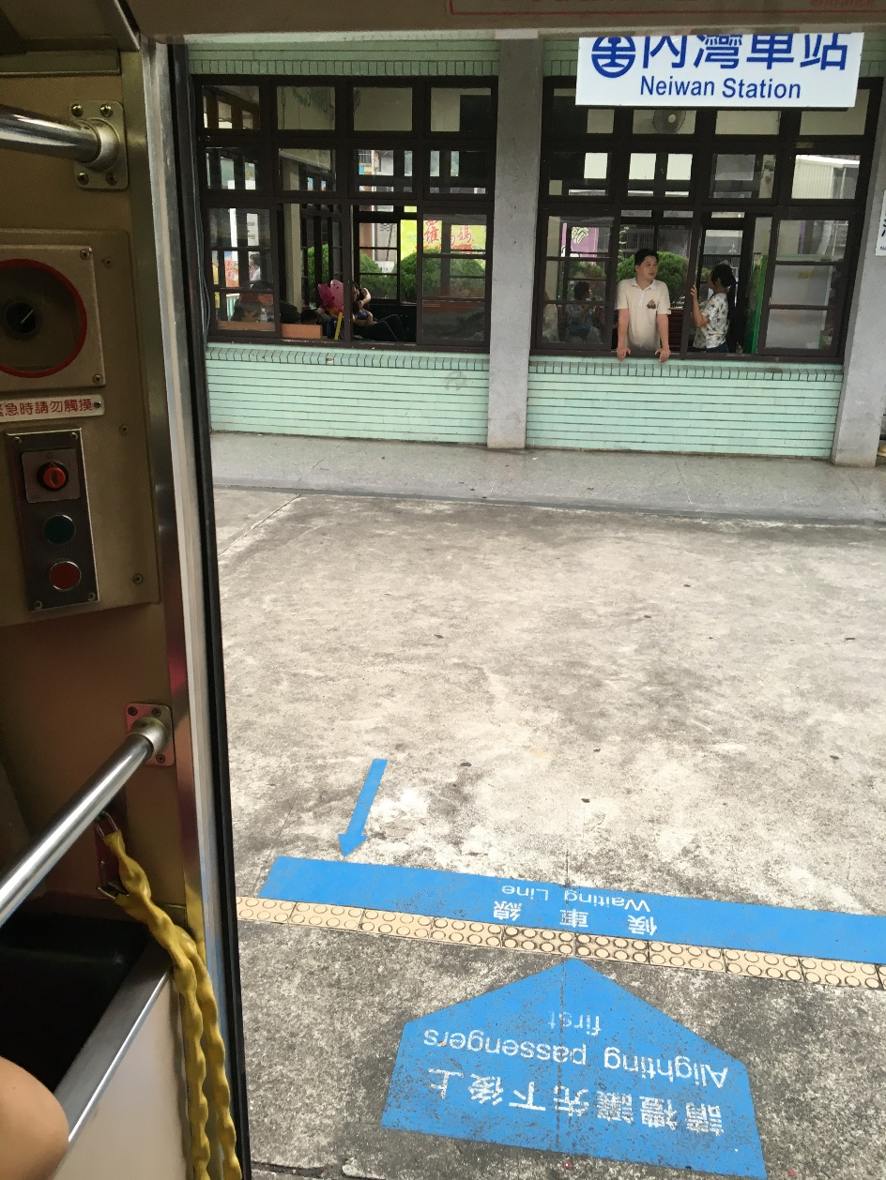
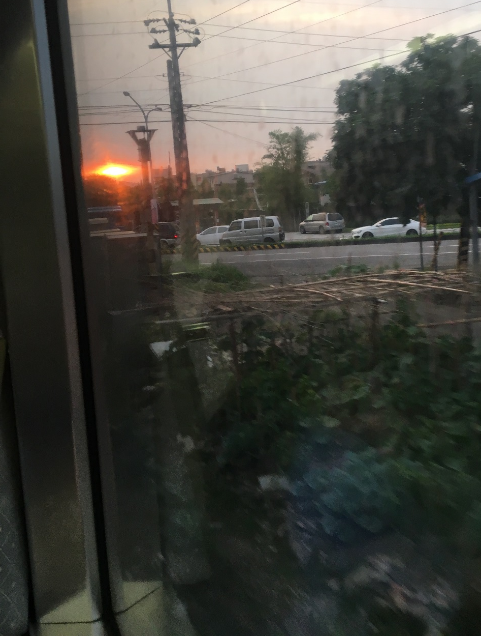
Process: Neiwan Trip, Returning home
Train to Hsinchu
Sunset

Slide 40
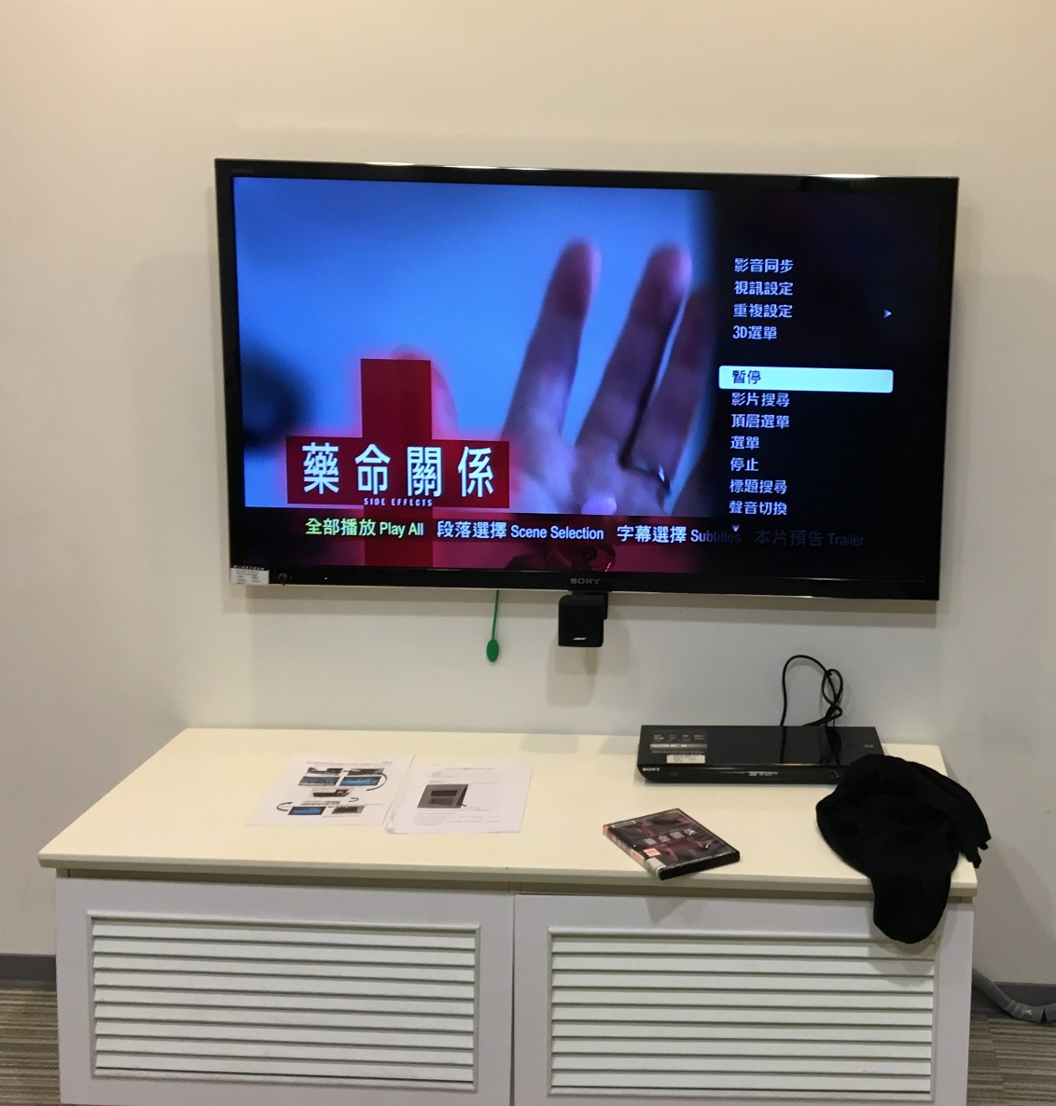
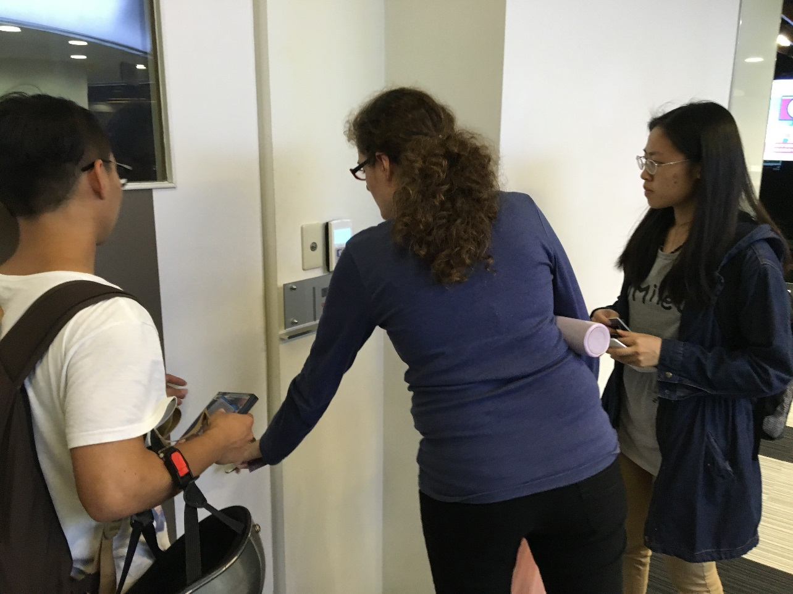
Process: Watching a movie, Where and what
NTHU Group Movie Room
Side Effects (2013), Drama, Crime

Slide 41
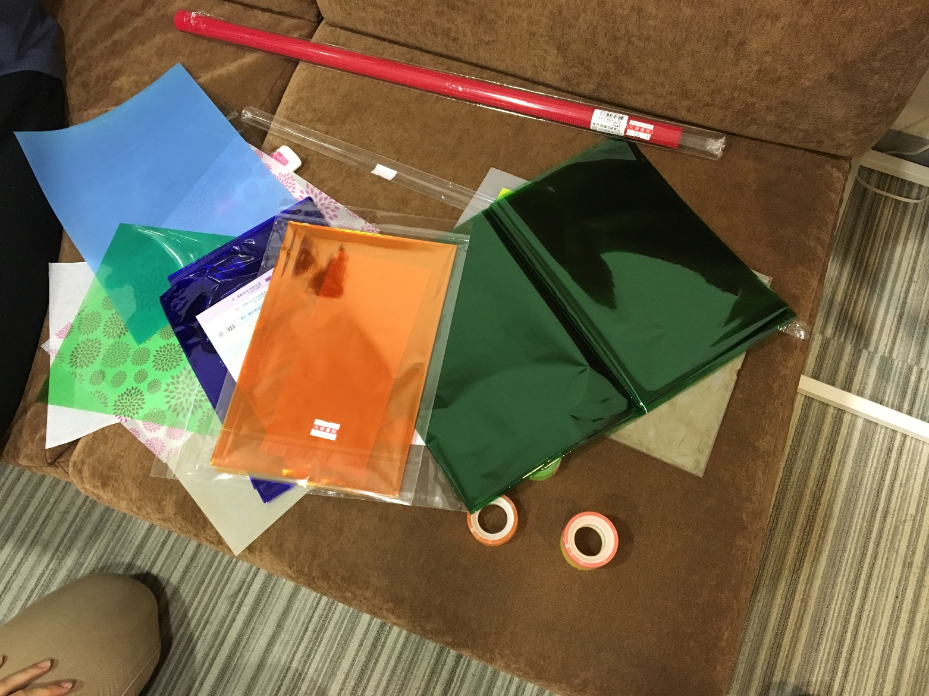
Process: Watching a movie, Designing glasses shades
Materials

Slide 42
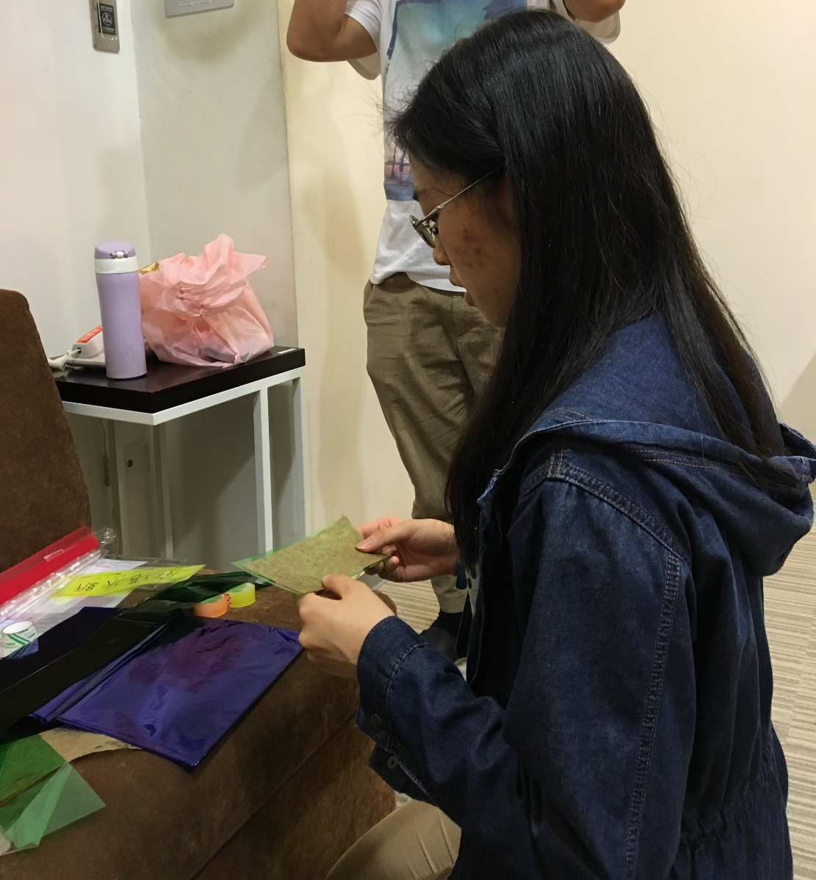
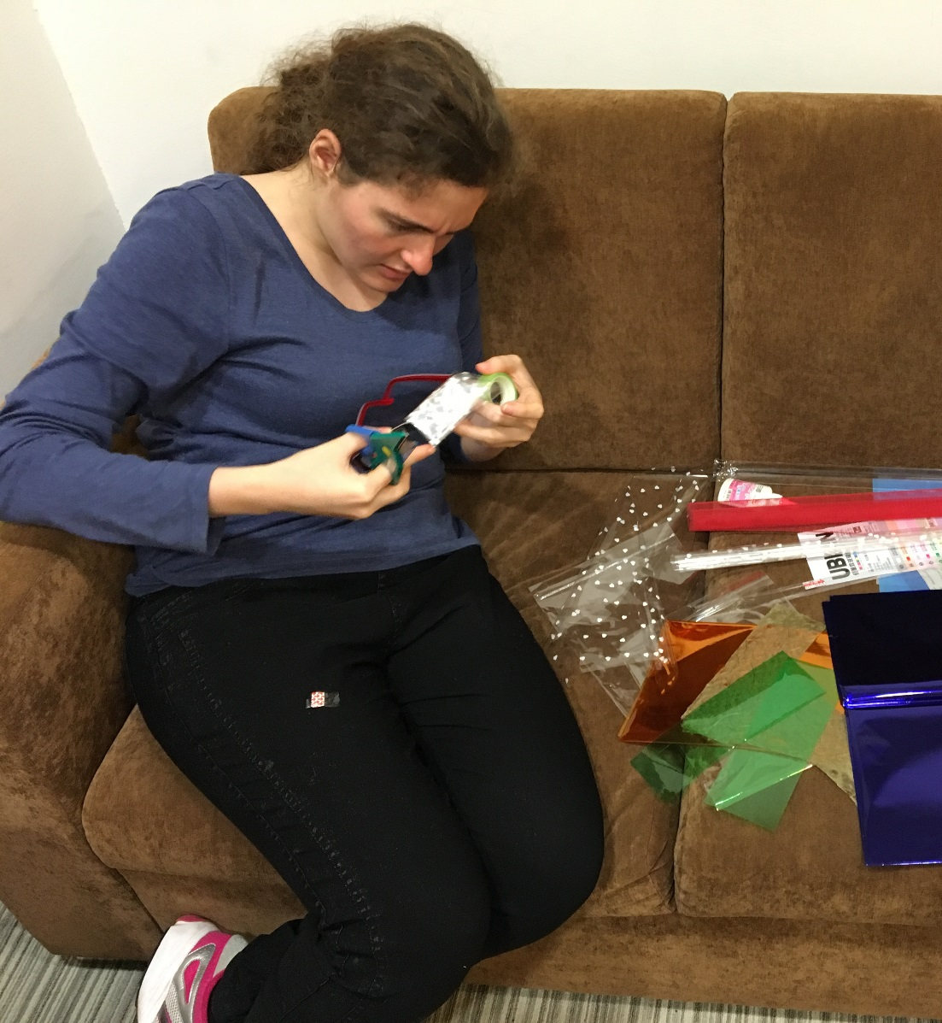
Process: Watching a movie, Designing glasses shades
Hannah designing
Eva working

Slide 43
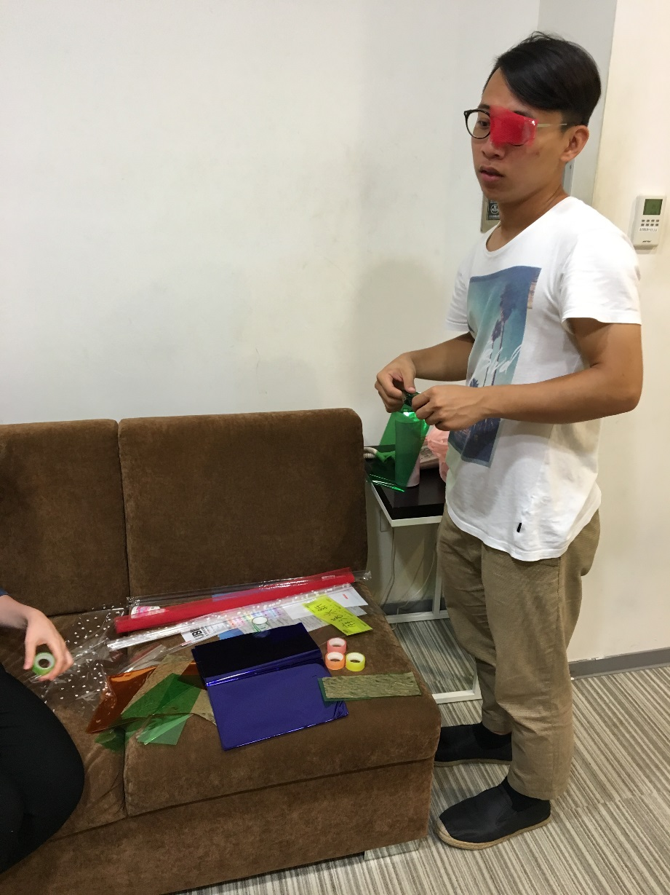
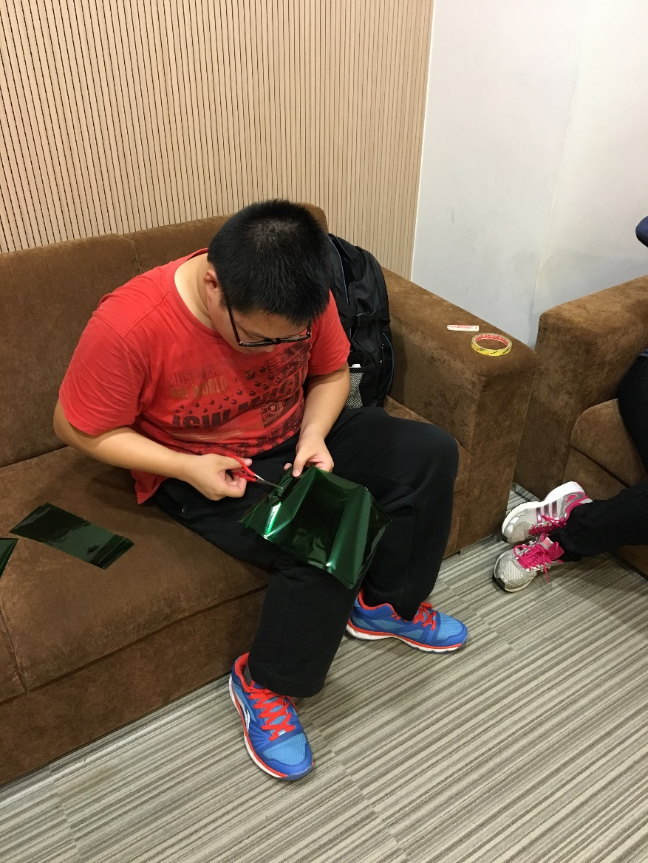
Process: Watching a movie, Designing glasses shades
Kido crafting
Eitima crafting

Slide 44
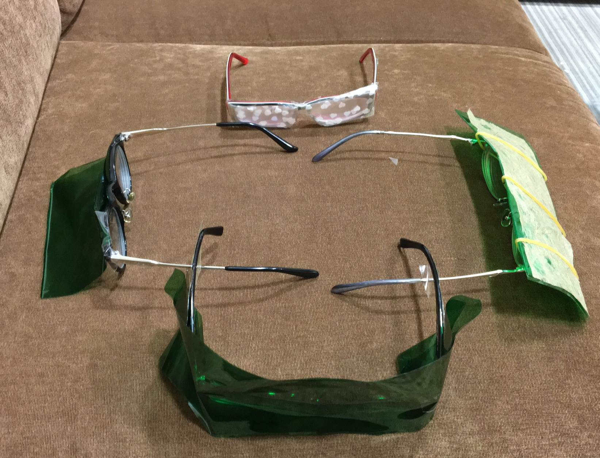
Process: Watching a movie, Designing glasses shades
Mission accomplished!

Slide 45
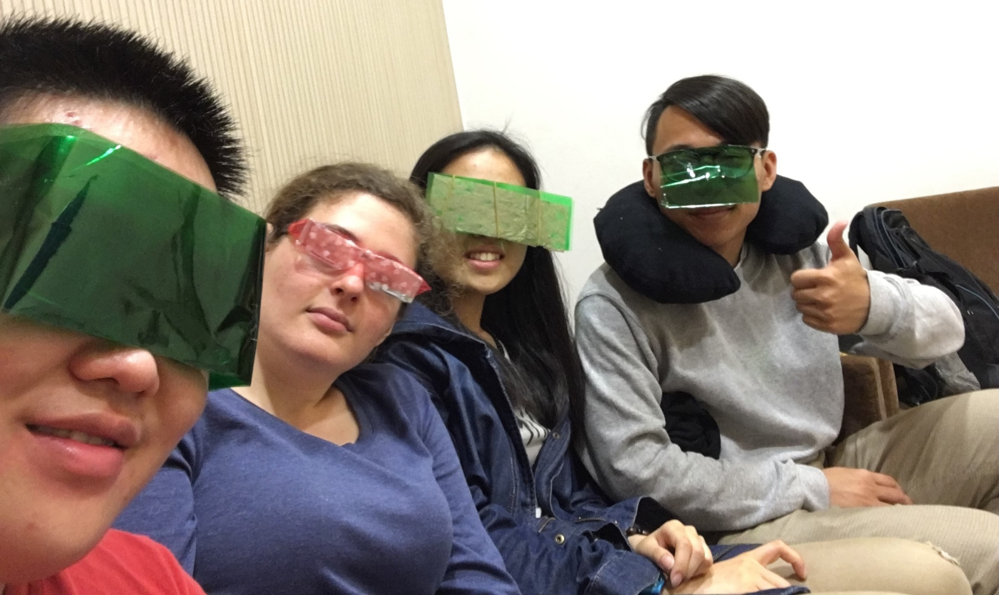
Process: Watching a movie, Designing glasses shades
Say “Hello” to everyone

Slide 46
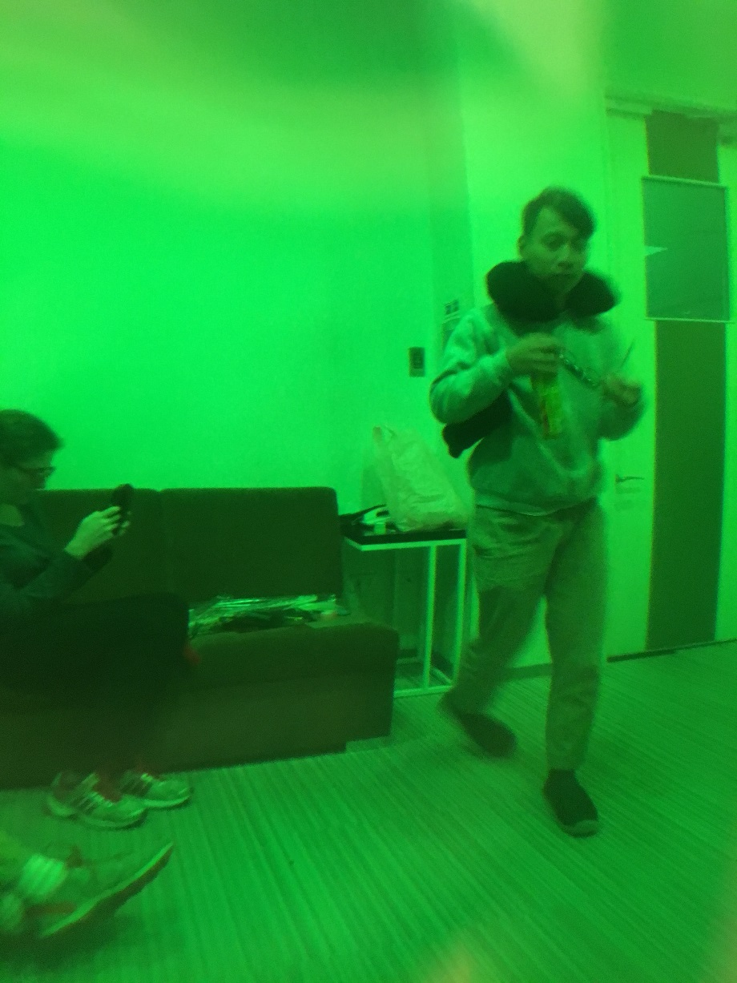
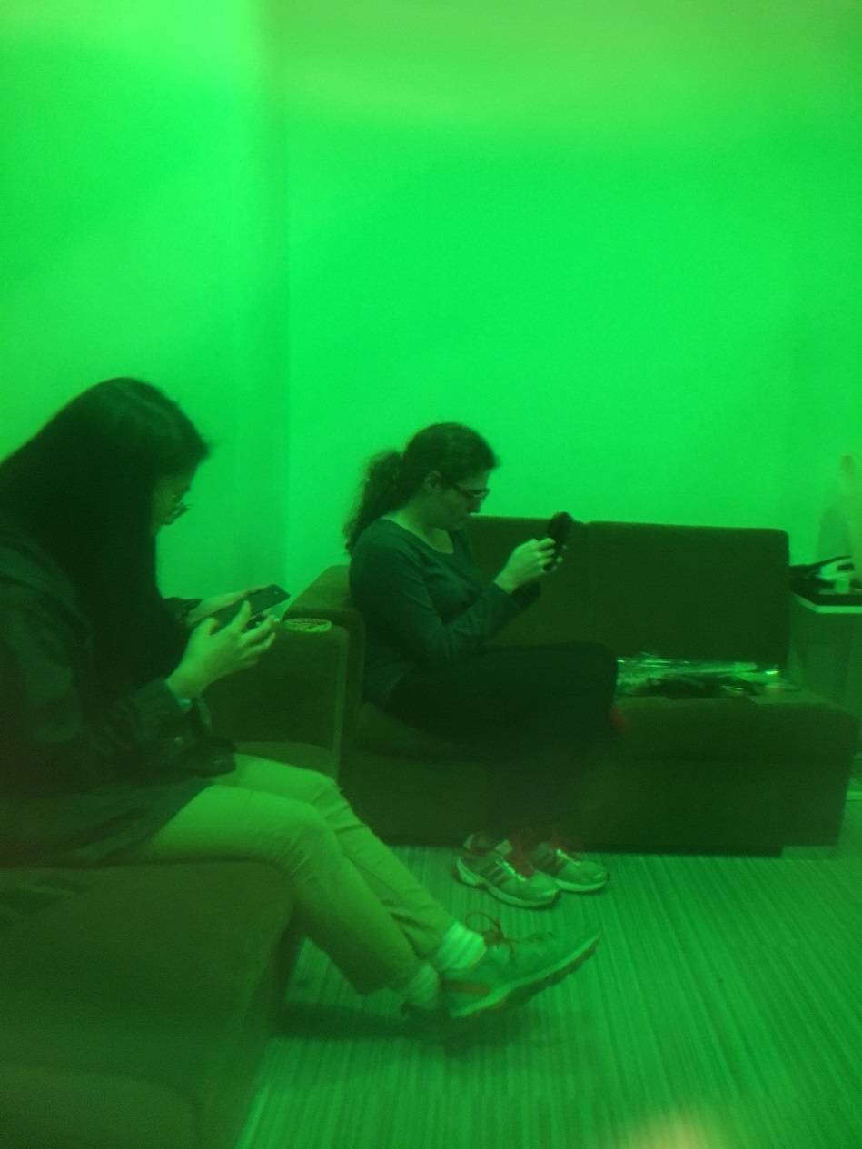
Process: Watching a movie, Designing glasses shades
Everything is green now

Slide 47
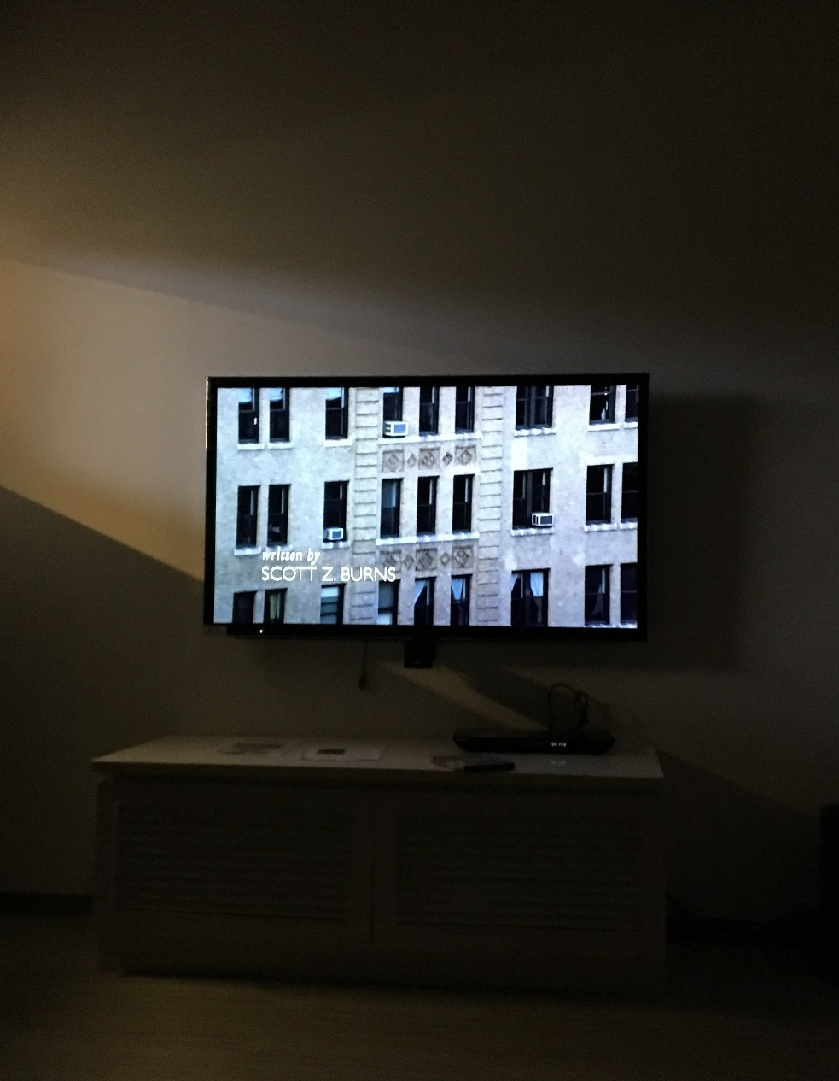
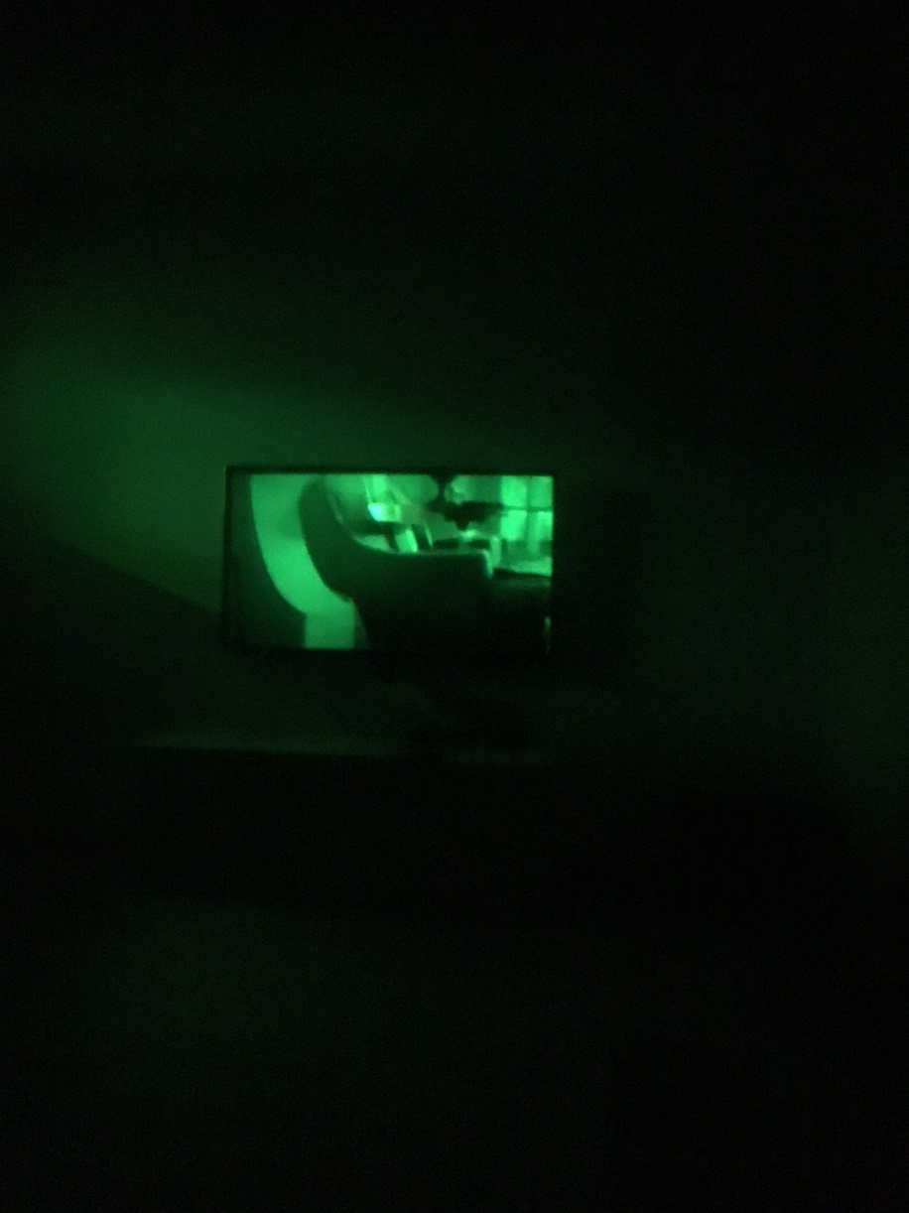
Process: Watching a movie, Watching the movie
Movie begins
Movie begins in our eyes

Slide 48
Problems And Solutions

Slide 49
Problems And Solutions: Outline
Neiwan Trip
  In-group communication
  Communication with others
  Expressing concrete concepts
Watching A Movie
  Physical Problems
  Feeling Problems

Slide 50
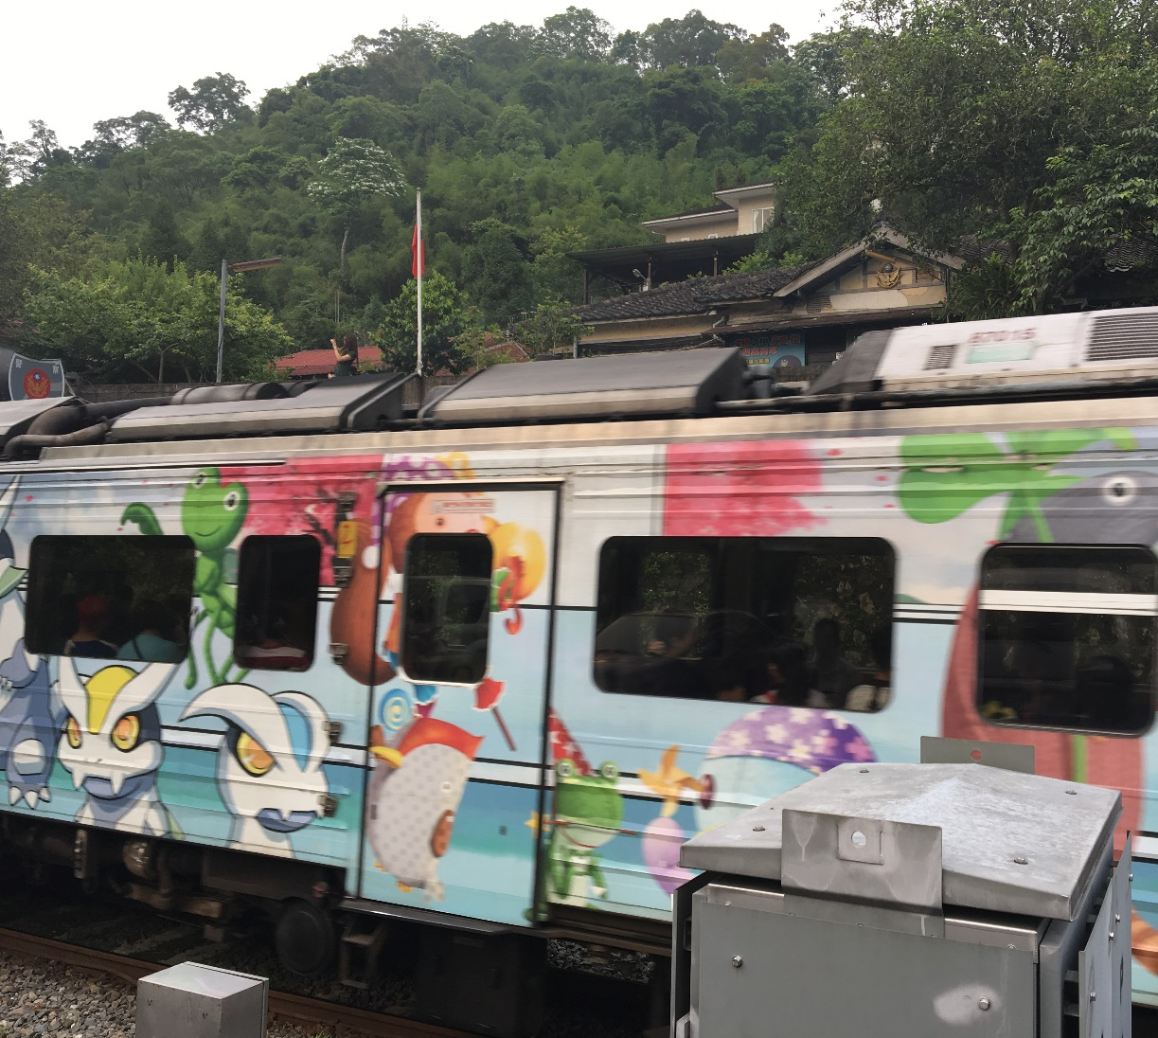
P&S: Neiwan Trip, in-group communication
Wrong train: Eva mistakenly believed the train approaching was the one they had to take, and since Hannah and Eitima had gone shopping, she got a little bit nervous.
Kiddo, who accompanied Eva at the train station, finally managed to realize what was wrong and signed to Eva the train to Neiwan was a different one.

Slide 51
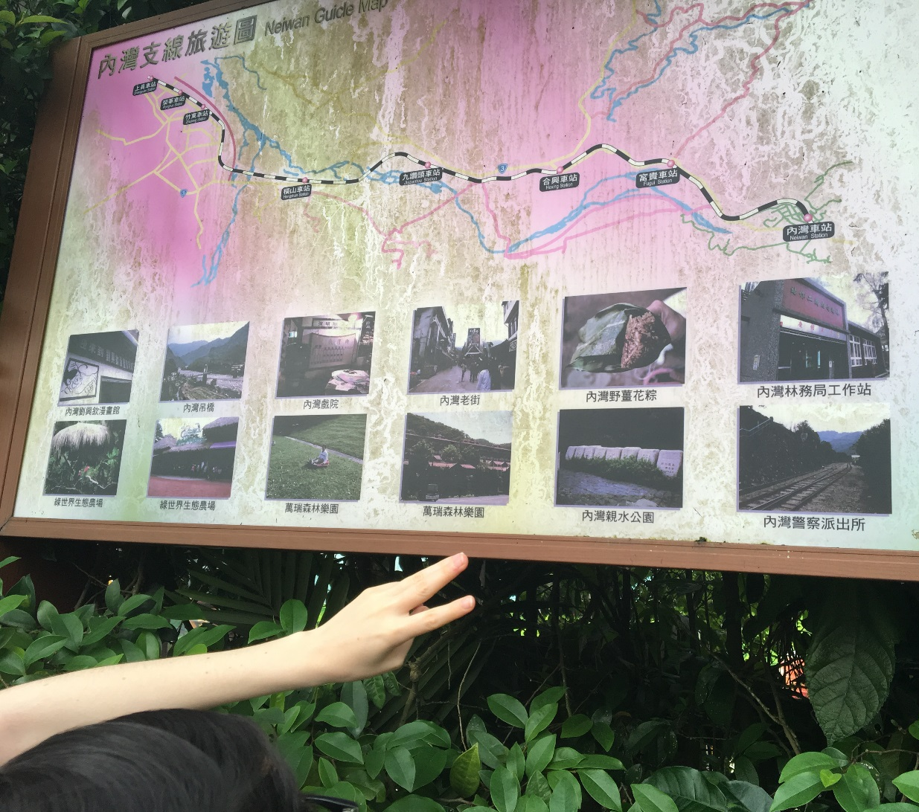
P&S: Neiwan Trip, in-group communication
Agreement on next destination: It is really hard to make agreement on where to go next since we couldn’t express our own ideas and also had trouble understanding others. Failing to reach an agreement made it harder to meet our schedule.
We were lucky enough to get a map from a local tour guide, which we pointed at to let others know where we wanted to go and voted for next destination.

Slide 52
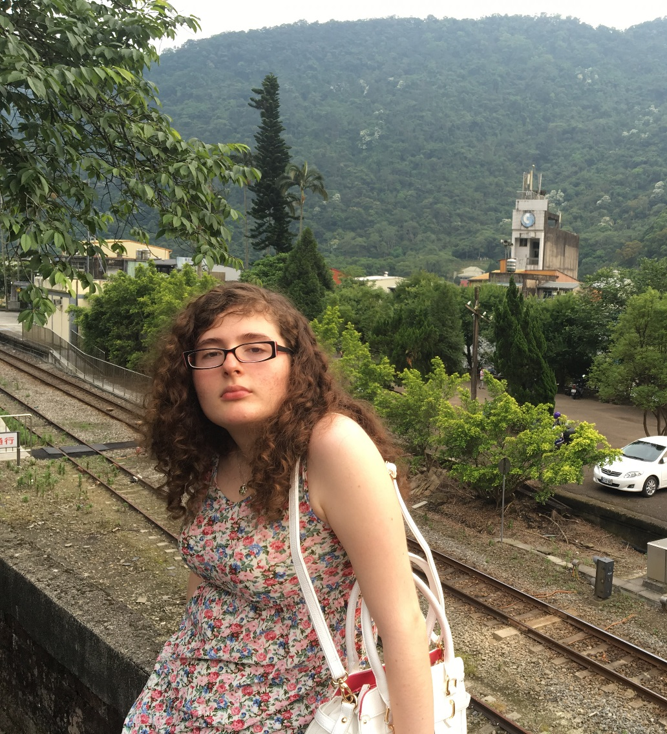
P&S: Neiwan Trip, in-group communication
Separated because of missing stuff: Eva wanted to communicate to her group members she had forgotten her stuff and didn’t know how to express it using signs. In addition, it was hard to unite once separated.
Other group members noted the anxiety in Eva’s face and through signs they found the absence of Eva’s bag. For reunion, we had no other choice but to resort to our cellphones. Even so, we still got lost and took some time to get together.

Slide 53
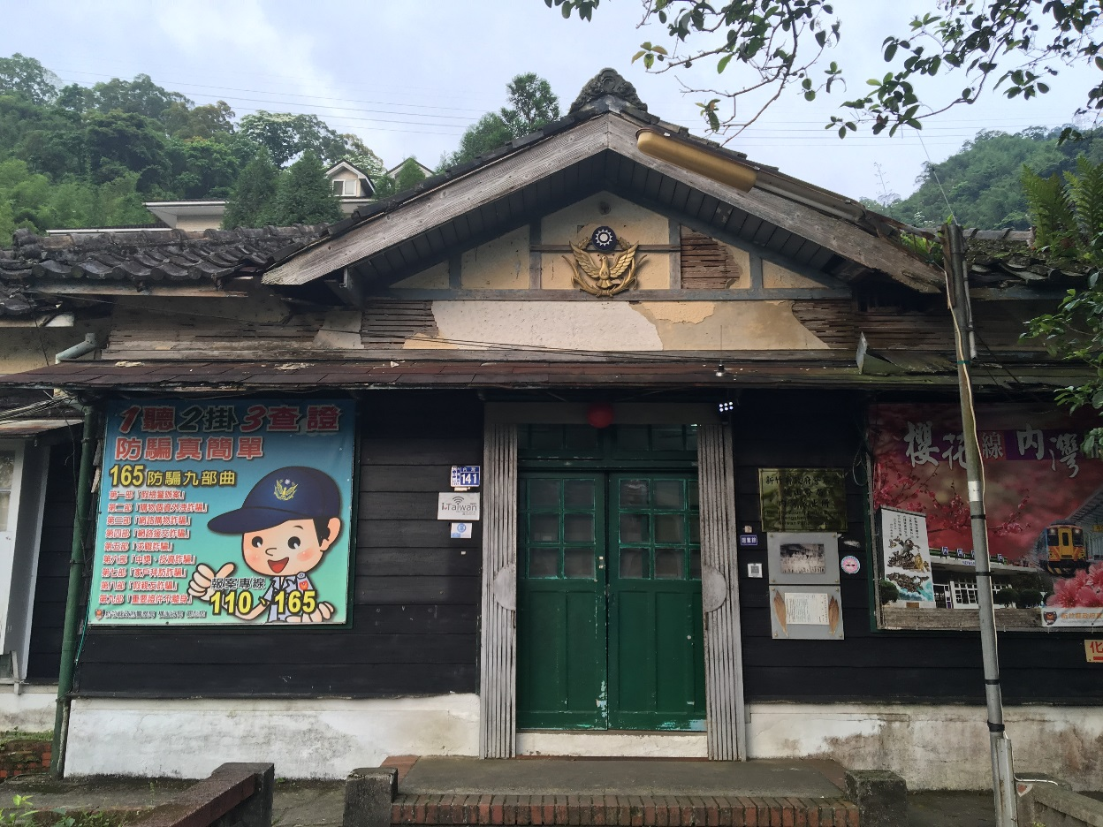
P&S: Neiwan Trip, communication with others
Closing gate: When Eva went to pick her stuff up it was hard to communicate with a policeman that was closing the gate and let him know that she’d be back soon, and that she wanted to return.
She had to make gestures of a purse and point to the place beyond the gate and back again for the policeman to wait.

Slide 54
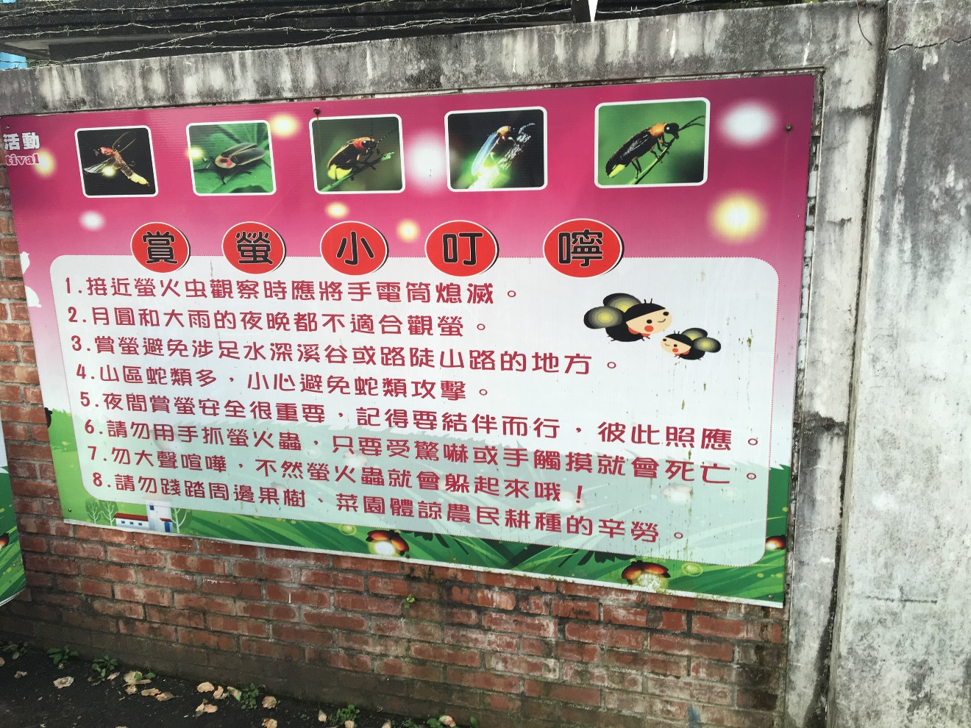
P&S: Neiwan Trip, in-group communication
Time to go home: Eitima mistakenly believed they wouldn’t come back until they saw the fireflies in the evening but Eva had to return early and we had a schedule to meet. They had trouble communicating numbers since they didn’t share the same gestures.
Eitima approached everyone in the group for the leaving time and finally confirmed the leaving time.

Slide 55
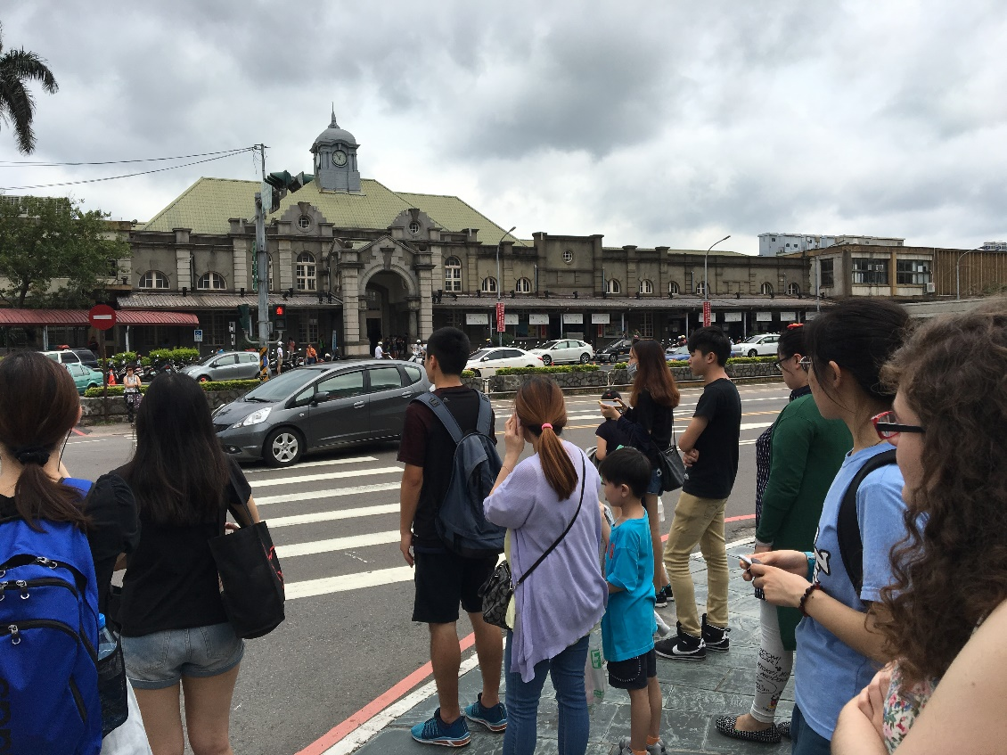
P&S: Neiwan Trip, in-group Communication
It was hard to meet the goals we had set for ourselves because of the time limit. We were constantly seeing the watch and everything took more time than expected.
This one was hard to solve, but we tried to be attentive of the time and do things more efficiently, not wasting time.

Slide 56
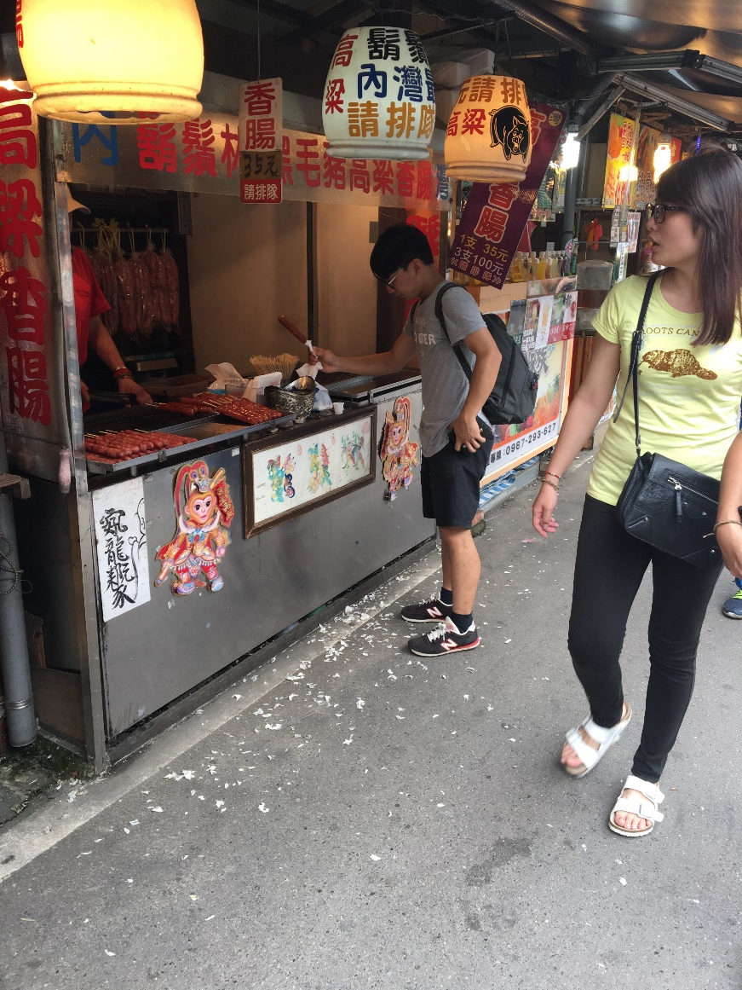
P&S: Neiwan Trip, communication with others
2 shop clerks actually knew some sign language to our surprise, but we didn’t, and thus weren’t able to communicate in sign language.
We smiled and kept gesturing, they understood and even though one of them kept signing until the end (believing maybe we understood), they helped us out.

Slide 57
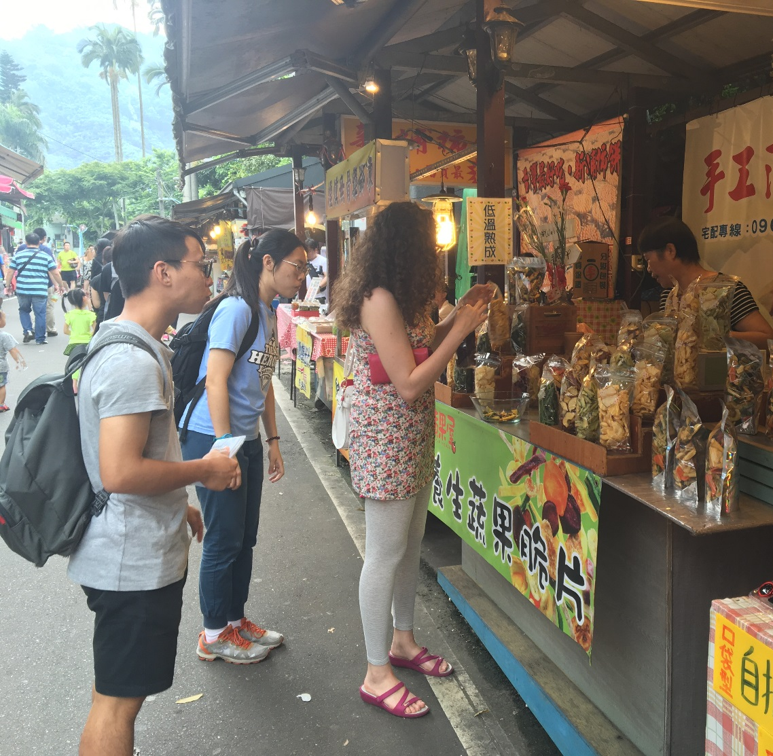
P&S: Neiwan Trip, communication with others
Mute or language barrier: Because of Eva’s appearance, some thought she couldn’t understand chinese and took her signs as a way to try to communicate despite the language barrier. They would ask her to wait and go look for somebody who could speak English with her only to be surprised when she still didn’t speak.
She had to sign at her throat and made a no sign for people to understand she was “mute”.

Slide 58
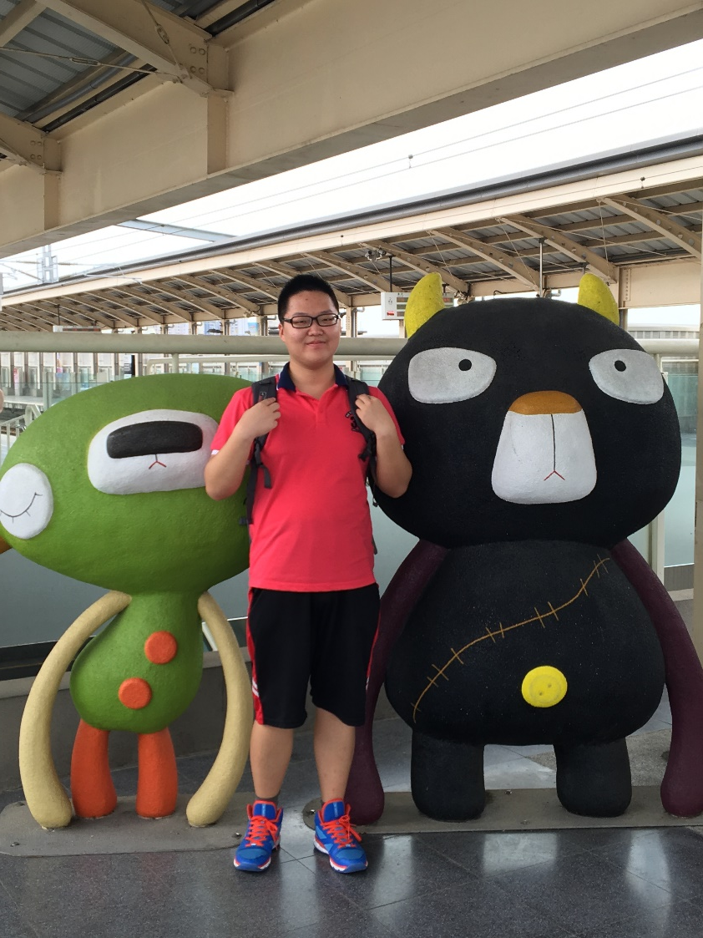
P&S: Neiwan Trip, communication with others
Neglect from clerks: The clerk may just believe we were wondering which to buy since I we couldn’t make a voice, especially when he or she was still preparing food for others. This can cause lots of frustration.
To be more active and to use dramatic body signs to get attention.

Slide 59
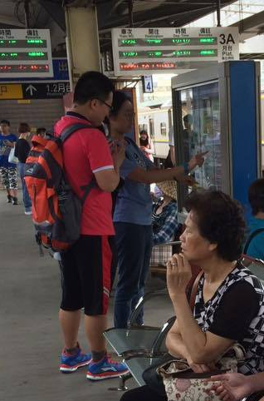
P&S: Neiwan Trip, communication with others
At first we struggled with trying to transmit messages quickly. One of our objectives was trying to be as independent as a non-mute person. This pressure, together with the pressure of interacting fast with vendors so as to not disturb them or take away too much of their time away, was enough to make us nervous at first.
By the end of the day, with practice, this process came more easily to all of us, but each interaction was still a struggle.

Slide 60

P&S: Neiwan Trip, expressing concrete concepts
Zhuyin: When Eitima was choosing the souvenirs, he needed to find the Chinese characters for his name. But all the order of the characters were of Zhuyin which he had never used before.
He used his cellphone. Others got it immediately and provided help.

Slide 61


P&S: Neiwan Trip, expressing concrete concepts
Legendary TRA lunch boxes: When we took the railway, Eitima really wanted to try the legendary TRA lunch boxes. But he couldn’t convey the concrete concept “TRA lunch boxes” to others.
He luckily found the TRA lunch boxes were advertised in the screens in TRA, so he readily pointed it to my partners and used my sign languages to express ”wanna eat”. But sadly, they didn’t seem to notice I was referring to the screen and still got confused. I gave my idea up eventually.

Slide 62

P&S: Neiwan Trip, expressing concrete concepts
Dry apples: Eva wanted to buy dry apples in a fruit shop, but describing it to the clerk was just hard.
She came up with a system of describing shape followed by its “use” (in this case, eating) and finally pointing at a color. In this case, she made a round gesture and pretended to be biting something out of my palm, then pointed at a red cellphone case lying on the table.

Slide 63

P&S: Watching a movie: physical problems
  Dizziness, headaches and soreness on the eyes: For those of us who used colored cellophane in front of their glasses, it was fine in the first place, except everything is of a greenish tint or something else. However, when we all finished three fourths of the movie (50 mins), we couldn’t stand the dizziness and headache for it and our eyes were sore.
We stopped for a while with our glasses off, about (5 mins), and things became much better then.

Slide 64

P&S: Watching a movie: physical problems
Reading subtitles: The subtitles were hard to read with the glasses with spots.
As Eva was reading subtitles, she moved her eyes slightly to get a better sight (as the glasses had white spots where visibility was completely blocked).

Slide 65

P&S: Watching a movie: feeling problems
  Since we muted the movie, the isolation and the need to focus on vision as the only sense available to us to process what was happening in the movie, watching it felt more like a task than anything else. Not being able to hear while having low vision was a little discomforting as one can really feel the isolation of not being able to communicate to others if needed. It feels very disorienting.
  By three fourths of the movie, we turned on the volume since some of us found it unbearable anymore. The sound was very helpful and we didn’t have to work as hard as opposed to when we muted the movie.

Slide 66

P&S: Watching a movie: Feeling problems
Characters’ emotion: In the first three fourths of our movie, we muted the voice and thus we could only rely on subtitles. However, when there were a lot of people speaking concurrently at a time, it was hard to determine who said what. In addition, we couldn’t feel the feelings of the characters if they didn’t show by actions because we can’t identify the tone of their speaking.
We tried our best to understand the plot so that we could guesses who said what and feel their emotion.

Slide 67
Reflections

Slide 68
Reflections: Outline
Reflections by Eva
  Muted Experiment
  Visual Impaired Simulation
  General Reflections
Reflections by Eitima
  Society
  Feelings when muted
  Feelings when wearing colored glasses
Reflections by Hannah
  On the Neiwan Trip
  On Watching the movie

Slide 69
Reflections: Eva
MUTED EXPERIMENT:
1. ON MY FEELINGS AND THOUGHTS DURING THE EXPERIMENT
Being mute for a day feels like being disconnected from the outside world in some way. Even when people try to help you, you don’t ever feel like the meaning ever goes through. One has to settle on efficiently choosing the bits of information one wants to transmit so that one won’t confuse the person one is trying to communicate with.
I also felt like there was a big part of my personality that was not showing through. Our choice of words, phrasing, tones and even onomatopeyas are a big part of how we present ourselves to the world, and it feels like we only exist partially without them. Even smiling felt different, distinctly silent.

Slide 70
Reflections: Eva
MUTED EXPERIMENT:
2. ON MY FEELINGS AND THOUGHTS AFTER THE EXPERIMENT
Being mute for a day reminded me of my first days in Taipei three years ago when I didn’t understand Chinese. Even through a lot of noise, I felt isolated in that I couldn’t understand anything anybody was saying at all. It was frustrating at first, but one developed patience in the end to make people understand your meaning. It became something that I can only describe as communication instinct: I don’t really understand how I managed to make people understand me, but slowly more and more people understood my meaning.
I would describe this experience as an emotional block, since I felt the need to express myself and talk so much once it was over. I never realized how much daily interactions with other people make me emotionally stable. Simple things as communicating with my classmates or making a joke while working don’t seem much, but it’s a lot for a person’s emotional stability.

Slide 71
Reflections: Eva
MUTED EXPERIMENT:
3. ON EXTERNAL FACTORS
People at Neiwan were extremely patient and helpful with us, despite the fact they were working at the time. I felt they were pretty good at overcoming communication barriers. My hypothesis is that they must deal with that as vendors with foreigners or other mute people. This hypothesis is supported by the fact that some of the vendors knew sign language. Perhaps it’s just a coincidence, perhaps they learnt sign language to communicate with mute customers.
I also hypothesize that vendors at Neiwan have a higher emotional intelligence because of all the one-on-one interactions they have with customers in a daily basis; and that their communication skills are better than that of people with other jobs where human interaction is limited. This would explain why they were so patient and how they managed to understand the meaning we were trying to convey even after some mishaps and misunderstandings.

Slide 72
Reflections: Eva
MUTED EXPERIMENT:
3. ON EXTERNAL FACTORS
I was also actually quite surprised by the convenience of technology for mute people. For example, instead of buying a ticket directly at the ticket booth, you can buy them only or just swipe your EasyCard at the entrance in front of the train platform.
Before this project, I didn’t really use the EasyCard that much, because you can always use real money to ride a bus or buy a ticket. However, I now understand this technology is not only a commodity for a non-”impaired” person: it’s also a huge help for mute/deaf people. Even at the convenience stores, it’s much easier to just swipe a card if you’re deaf.
It also made me think that even when this kind of technology is indeed helping “impaired” people, it’s also breaking daily communication with people and isolating us.

Slide 73

Reflections: Eva
VISUALLY IMPAIRED SIMULATION :
The topic of Visual Impairment is a really sensitive topic for me. Due to a genetic disease as well as an improper surgery she underwent about 25 years ago, my mother has this problem. Growing up, I have been able to see how she has struggled against this and the “Legally Blind” diagnosis she was given by various doctors throughout her life.
Growing up, she would often ask me to read things for her as the letter was to small for her to read. Alternatively, she would use a magnifying glass to read it for herself, but it usually took her longer. We saw her struggles every day and tried to be as supportive as possible, even when helping her out would sometimes take sometime away from us. Sometimes, like a really bratty child, I would complain over it, although I was mostly happy that I could help her in some way.

Slide 74


Reflections: Eva
VISUALLY IMPAIRED SIMULATION :
It was always hard for me to see her struggle against doctors who would deem her case irreversible. She would search for medicines, herbs, and other methods to try and take matters into her hands and improve her vision. When she worked, she would always put extra hours at work and bring reading materials to home to make up for the time and fulfill her responsibilities.

Slide 75

Reflections: Eva
VISUALLY IMPAIRED SIMULATION :
I always wondered how the world was through her eyes, until one day in a biology class we studied how the eyes worked and we saw a picture of the simulation of how a similar genetic disease affects sight. With this in mind, I made my glasses with a cellophane paper with little white hearts to simulate the black spots she sees. The spots completely blocked visibility. A net was added in front to blurry vision even more.

Slide 76
Reflections: Eva
VISUALLY IMPAIRED SIMULATION :
  My mom used to tell me she used to move her eyes, so that the white spots in her eyes would also move. She could then see things with the clear parts of her vision, usually with the corners of her eyes, which she told me got used to that with time.
  I remembered this when watching the movie, and moved my eyes around a little bit (even though the spots where fixed because they were in my glasses as opposed as the retina). It was a little tiring because I’ve never had to move my eyes that much. By the end of the movie, my eyes were really dry and sore, I had a headache, and when I removed the glasses my eyes had to readapt to normal lighting again.
  Although I did understand the movie because of the context, I missed a lot of dialogue details. And sometimes confused the meaning, since it was a movie with a complicated plot. I had to correct my interpretations of the movie, the characters and the circumstances as I was watching the movie.

Slide 77
Reflections: Eva
GENERAL REFLECTIONS:
  ON HOW I VIEW THE TERM DISABILITIES
  This is not an experiment I would like to share with my mother. I know it’s a sensitive issue for her and even if I know she wouldn’t take it badly, I have to say I’m ashamed that even a small experiment like this one would give me a headache when she has to struggle with it everyday.
  I certainly wish that more people were aware of this condition and above all of the efforts people with this symptoms make to get on with their daily lives. How they are the strongest people because of the difficulties they encounter everyday that have shaped them. How resourceful they are in finding tools to help them with those symptoms .
  I also hate using the word “disabilities” or “impaired” because of the experience I lived with my mom. She felt hurt and angry whenever doctors told her that her disabilities couldn’t let her work or do certain things. She never listened to them, she focused in finding ways to get around those symptoms and still lead a normal life.
  I wish more people tried to avoid this word, and to understand that it belittles them instead of the empowerment they should fell from us .

Slide 78
Reflections: Eva
GENERAL REFLECTIONS:
  ON THE EXPERIMENT ITSELF IN CONTRAST WITH THE REALITY OF PEOPLE WITH THOSE CONDITIONS
  People with these conditions are often much stronger than us: they deal with much more than us in a daily basis, they often do it by their own since some of them are seldom in contact with other people with their same condition.
  And yet, they manage to “appear normal” to avoid unnecessary judgments from people that just don’t understand the condition. Only really close people to them get to see what their struggle really is, and only the person himself/herself knows what it feels to live that way.
  Making the experiment is enough to give you a little taste of what the disability might feel like, but the daily emotional struggle against complex emotions of anger, frustration, loneliness can’t be replicated by an experiment.

Slide 79
Reflections: Eva
GENERAL REFLECTIONS:
  2. ON THE EXPERIMENT ITSELF IN CONTRAST WITH THE REALITY OF PEOPLE WITH THOSE CONDITIONS
  If I can transmit something to my classmates, it’s precisely this: what predominates in this kind of short experiments is the helplessness one feels as one is not used to the particular disability.
  That is something the person herself/himself doesn’t experience (at least as frequently); as they’re used to that condition, it’s part of their reality and in some cases (like in the case of blindness from birth), they don’t have any other way of living to compare it with.
  The real struggle for them is in coping with their environment, reclaiming their independence (specially in the case of partial impairments) , and trying to accomplish the same as us, normal people.
  It’s a much more complex issue that just can’t be simulated.

Slide 80
Reflections: Eva
GENERAL REFLECTIONS:
  ON HOW PEOPLE AROUND A PERSON WITH AN “IMPAIRING” CONDITION CAN DO
  Looking back, I realize that there are lots of missed opportunities that I could have used to try and help my mom. Ignorance about her condition is not an excuse that justifies it.
  Although I did try to help her my best, there’s always something more you can do. The following conclusions are in part self-reflecting on my experiences, but they also go beyond that: they reflect behavioral instincts that we have in solidarity to people in general. This is something that we can all tap into if we stop for a minute and think about a person and how he/she lives as opposed as imagining our own behavior and responses to their situations. It implies you have to get to know that person too, to understand the way he/she sees life.
  a. A little comprehension goes a long way. You might not be able to understand the specifics of the circumstances that person lives in because of his/her condition; but you can try to spare some time to put yourself in her/his shoes, and more importantly, see how that person sees and faces potential difficulties.

Slide 81
Reflections: Eva
GENERAL REFLECTIONS:
  ON HOW PEOPLE AROUND A PERSON WITH AN “IMPAIRING” CONDITION CAN DO
  b. Sometimes they won’t reach out to you and ask for help because they’re used to living with those conditions. But a little observation and sensitivity will let you know when you can help a little bit. Small things in everyday life might not seem much but they’re certainly making a difference in that person’s life.
  c. Sometimes, we might do or say somethings that might hurt them without meaning to. So, be careful with the words you say and how you say it.
  Be attentive of the other persons’ reaction and don’t be afraid to ask her/him to tell you if you say something hurtful.
  d. Take it upon yourself to try and make it up to that person for some of the hard times she/he has because of their conditions.; specially if it’s someone close to you. The more time you pass with them, the more you’ll understand about them; and the more opportunities you have to do something for them.

Slide 82
Reflections: Eva
CONCLUSIONS:
  ON HOW PEOPLE AROUND A PERSON WITH AN “IMPAIRING” CONDITION CAN DO
  The relationship you will build with an emotional intelligent people who has gained such intelligence will enrich you as a person and deepen your emotional intelligence thus bettering the quality of your relationships with other people. Besides of having a beautiful, deep relationship in your life. It will also teach you to be more selfless and enjoy other people’s happiness as much as your own.

Slide 83
Reflections: Eva
CONCLUSIONS:
  4. ON HOW I FELT AFTER THIS COUPLE OF EXPERIMENTS
  Being on my own in Taiwan, I feel like my only responsibility is study, and it feels wrong in someway that I am completely dedicated to doing something completely selfish (getting a degree) .
  I do feel the urge to do something selfless for people with “impairments” or living “under difficult situations” in a sensitive way and not in a superficial /touristic/altruistic way; specially towards people with sight issues, since I’m a little acquainted with some of the issues related to this condition. I feel responsible for having this knowledge as well. I do feel guilty every once in a while but I try to push those thoughts to the back of my mind, specially because “I don’t have time”.
  But I feel like I should the effort to make time eventually, and stop making excuses.

Slide 84
Reflections: Eva
CONCLUSIONS:
  4. ON HOW I FELT AFTER THIS COUPLE OF EXPERIMENTS
  This experiment has also made me feel a little surprised on the lack of general knowledge on certain conditions to be honest; and it has made me realize that I should make an effort and transmit this to more people so that they can be empathetic if they encounter a person with this situation and understand their position.
  Finally, this experience also made me think of how much I stare fixatedly into computers because of my major(Computer Science) and that it would be a good idea to rest my vision every once in a while and lift my eyes when I’m working in my computer as opposed as staring fixatedly to the screen.

Slide 85

Reflections: Eitima
Society: People in Neiwan are generally very helpful and warm-hearted. Once they noticed our inability to talk and understand Chinese, they resorted to any possible ways to communicate their ideas, such as signs. I still remember when I was buying some fruit maltose (水果飴) in one shop, the clerk asked me to choose a taste. He asked ”綜合？”, but I failed to understand maybe because of his accent. Upon seeing my confusion, he immediately asked again in English “mixed?”. I got really impressed and successfully made my choice. Thus,
I think society is a warmer place than I thought before and we really need to appreciate it and try our best to make it better.

Slide 86
Reflections: Eitima
Feelings when muted: Being a muted person really restricts you a lot on the condition that you don’t have other ways (e.g. cellphone) to express yourself. Not only would you feel frustrated when you’re neglected or when you fail to express your ideas but you would also lose opportunities to choose or to make a voice. This is what I didn’t expect before we conduct the empathy exercise. My enthusiasm to convey certain concrete concepts was soon lost and when I went to the shop for something, I just chose whatever that I could point to the clerk and lacked confidence to express what I really hoped to get. In addition, in group discussion part, when I couldn’t get others ideas or couldn’t get my opinion across several times, I just wanted to give up and leave the opportunities to determine to others. Thus I believe for the muted to live a normal live, it is a sine qua non to possess methods to communicate with others, such as mastery of elaborate sign language or carry-on pen and paper or electronic devices.
Feelings when wearing colored glasses: Apart from dizziness and sour that real people with visual problems (such as colorblind) may not feel, what they may have trouble is to appreciate any visual media, such as movie and paintings. The light setting that is comfortable for normal people may be too brilliant for them to enjoy as in my case, any frames that includes part of the sky were unbelievably dazzling and I had to close my eyes to avoid the light.

Slide 87
Reflections on Neiwan Trip: Hannah
Mute ( cannot speak )：Not until I have done this empathy exercise can I experience how inconvenient and suffer for those who cannot speak. In my point of view, most people that I met during the activities are very kind. Although they could only understand limited information that I want to express, the owners and the staffs still tried hard and guess what I would like to tell them, and I really appreciate that. However, I think the most difficult part is not communicating with others, but our in-group conversation. It is extremely hard when I want to convey my thoughts and feelings to my team members, since they are so abstract and not like buying things, which I can just point out what I want. I feel very confuse and upset when I am not able to share my opinions to other.
Act as a foreigner：Although I have travel abroad before, it feels very different this time, since we not only cannot understand Chinese, but also cannot speak. When I was asking the local people for help, they tried to use simple English to communicate with me, and also use lots of body languages. This is how I get to know why many foreigners love Taiwanese so much. The people are so cute and warm-hearted！

Slide 88
Reflections on Watching the Movie: Hannah
Mute ( cannot hear )：This is the first time that I watch a movie without turning on the voice. Before the activity, I thought that it would be very boring since the sound is an important factor that would affect the feeling when watching a video. However, when all the sound were turned down, I feel that it is easier for me to concentrate on the movie. Although the movie wouldn’t be as exciting as the sound were on, I can focus more on the story behind the actions.
Special eye glasses with cellophane and transparent paper with some dots on it ：The purpose of this exercise is to know how the people with eye diseases may feel. In this activity, I cover my eves with green cellophane and a paper with several tiny holes. Seeing out from the glasses, everything turns out to be green ,and there is no other colors, but only light green and dark green. When I use the glasses to watch a movie, I feel dizzy in a short time, and my eyes were very uncomfortable , dry and sour. Another special thing is that, when I take off the glasses, suddenly everything looks a little bit red. As far as I am concerned, It is because green and red are complementary colors.
Conclusion：I think it is an unforgettable activities that makes me think a lot afterward, and I have a deeper feeling and more empathy about how the people with physical defects would think.

Slide 89
Ideas for Social Improvements

Slide 90
Ideas for Social Improvements: Outline
Neiwan Trip
  Translator near the tourist spots
  Indicators with more picture than words
  Technology facilitating daily tasks without need of communication
Watching A Movie
  Slow motion
  Special design for those with eye diseases
  Technological features for the Visual Impaired

Slide 91

  Social Improvements : Neiwan Trip,
  Translator near the tourist spots
Since there would be many foreigners from different countries around the world and they speak their native language, most of the time they couldn’t understand what the local people are trying to say.
If there is such a translator near those famous sites, it would be more convenient for foreigners , and they could have spend less time explaining their own thoughts.

Slide 92

  Social Improvements : Neiwan Trip,
  Indicators with more picture than words
As we were doing the empathy exercises, we found it hard not only to communicate with others, but also to express you own feelings and ideas to others, especially the abstract thoughts.
It is easier to use pictures or marks to convey the ideas than to use only words. In addition, we can point to the picture to tell how we feel, but it’s really hard if only by words.

Slide 93

  Social Improvements : Neiwan Trip,
  Technology facilitating daily tasks without need of communication
Technology really is a blessing for people with conditions lite muteness and deafness. I.E.: Cellphones, EasyCard, access to information through websites,…
By thinking of their needs while developing this kind of technology, we can better help them lead a more independent life free of limitations for trivial daily events.

Slide 94

  Social Improvements : Watching A Movie,
  Slow motion
When we cover our eyes with different colors of cellophane and transparent paper with some dots on it, after watching the movie for a while, all of us feel a little dizzy and uncomfortable.
If the movies were displayed in a slow motion, it may have cause less harm to our eyes, and wouldn’t be so uncomfortable.

Slide 95



  Social Improvements : Watching A Movie,
  Special design for those with eye diseases
Since most of us choose green cellophane, it turns out that when we take off the special glasses, we will feel that everything looks a little bit red, which is the complementary color of green.
If it is possible to modify the color according to each individual patient with eye diseases, it would be better for them to watch movies, or even cellphones and things with electronic screens.

Slide 96

  Social Improvements : Watching A Movie,
  Technological features for the Visual Impaired
In the case of the glasses with white spots, it would have been easier to read the subtitles if the font had been bigger. It’s easily settable, but there’s no way to change the size of the subtitles. Changing the font size is not that hard of a functionality, but the ignorance on their condition led to the designers of these technologies to omit features of the kind.
Again, sparing a thought for people with “impairments” while developing these technologies might help them to benefit from modern technology.

Slide 97
Thank you !

