Slide 1

Machine Learning Workshops
— Unsupervised Learning—
Zexi Huang
Department of Computer Science
University of California, Santa Barbara
Notes:
1

Slide 2
Outline
Introduction
Clustering:
  Partition-based method: K-means
  Density-based method: DBSCAN
Dimensionality Reduction:
  Linear transformation: PCA
  Nonlinear transformation: LLE
Deep Learning for Unsupervised Learning
2
2
Notes:
2

Slide 3
Outline
Introduction
Clustering:
  Partition-based method: K-means
  Density-based method: DBSCAN
Dimensionality Reduction:
  Linear transformation: PCA
  Nonlinear transformation: LLE
Deep Learning for Unsupervised Learning
3
3
Notes:
3

Slide 4
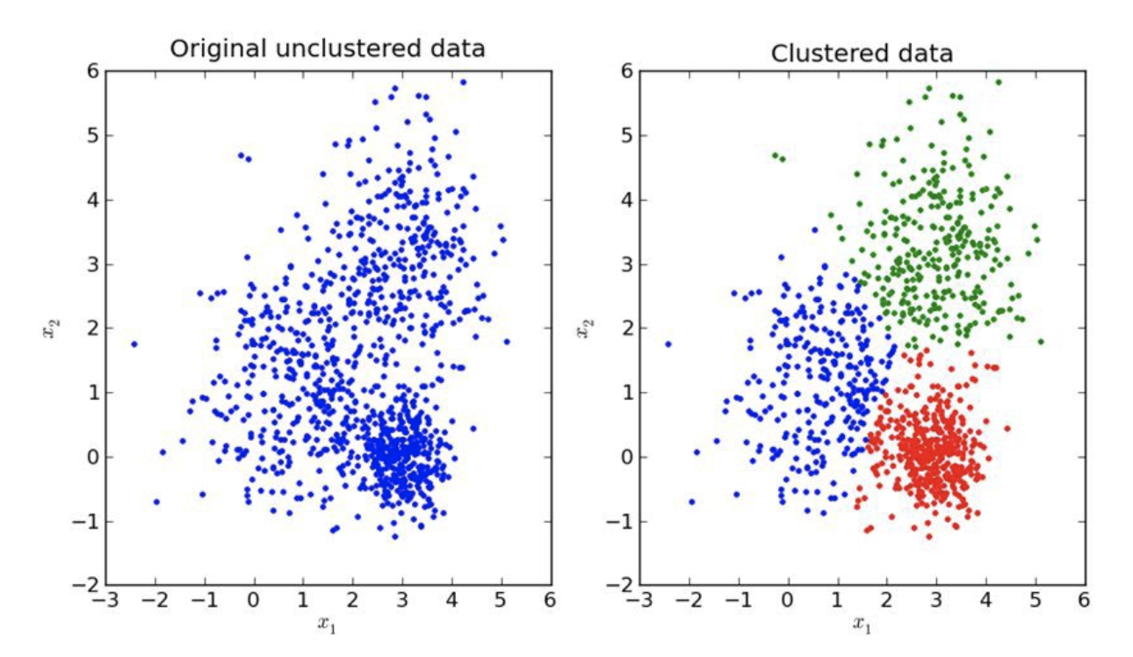
Supervised vs Unsupervised
Supervised Learning
  Learning by examples.
  Given labeled data points (X, y), learn the mapping from X to y.
Unsupervised Learning
  Learning by observation.
  Only given unlabeled data points X, learn the data patterns/summary.

Slide 5
Applications
Clustering: a stand-alone tool to get insight into data distribution
  Marketing: Help marketers discover distinct groups in their customer bases, and then use this knowledge to develop targeted marketing programs.
  City Planning: Make groups of houses and to study their values based on their geographical locations and other factors present.
  Biology: Generate taxonomy of living things: kingdom, phylum, class, order, family, genus and species.
  Climate: Find patterns of atmospheric and ocean.
  …
Dimensionality reduction: a preprocessing step for other tasks
  Preprocessing for regression, classification and other tasks.
  Data visualization in 2D/3D space.
  Data compression in image processing.
  …

Slide 6
Outline
Introduction
Clustering:
  Partition-based method: K-means
  Density-based method: DBSCAN
Dimensionality Reduction:
  Linear transformation: PCA
  Nonlinear transformation: LLE
Deep Learning for Unsupervised Learning
6
6
Notes:
6

Slide 7
Clustering
Cluster: A collection of data points
  similar (or related) to one another within the same group
  dissimilar (or unrelated) to the objects in other groups
Clustering (or cluster analysis, data segmentation, …)
  Finding similarities between data according to the characteristics found in the data
  and grouping similar data points into clusters
Similarity/Distance metrics:
  Similarity is expressed in terms of a distance function d(x,y)
  The definitions of distance functions are usually rather different for interval-scaled, boolean, categorical, and vectors
  Example: Euclidean distance between continuous vector data points: d(x,y)=||x-y||

Slide 8
Measuring Clustering Quality
Two methods: extrinsic vs intrinsic
Extrinsic: i.e., the ground truth is available
  Compare a clustering against the ground truth using certain clustering quality measure
  Ex. Normalized mutual information (NMI)
Intrinsic: i.e., the ground truth is unavailable
  Evaluate the goodness of a clustering by considering how well the clusters are separated, and how compact the clusters are
  Ex. Silhouette coefficient
8

Slide 9
Major Clustering Approaches
Partitioning-based
  Construct various partitions and then evaluate them by some global objective function, e.g., the sum of square distances within clusters. Then, we select the partitions with best objective value.
  Typical methods: K-means, k-medoids, CLARANS
Density-based
  Group points that are densely packed together, i.e., points with many nearby neighbors
  Typical methods: DBSCAN, OPTICS, DenClue
Hierarchical: Finding a hierarchy of clusters.
Grid-based
Model-based
Frequent pattern-based
User-guided or constraint-based
Link-based

Slide 10
Outline
Introduction
Clustering:
  Partition-based method: K-means
  Density-based method: DBSCAN
Dimensionality Reduction:
  Linear transformation: PCA
  Nonlinear transformation: LLE
Deep Learning for Unsupervised Learning
10
10
Notes:
10

Slide 11
Partitioning-based Clustering: Basic Concepts
Partitioning method: Partitioning the data points into a set of k clusters, such that the sum of squared distances between each point and the centroid or medoid in each cluster is minimized
Given k, find a partition of k clusters that optimizes the partitioning criterion
  Global optimal: exhaustively enumerate all partitions (exponential!)
  Heuristic methods: k-means and k-medoids algorithms
  k-means (MacQueen’67, Lloyd’57/’82): Each cluster is represented by the mean of the cluster
  k-medoids (Kaufman & Rousseeuw’87): Each cluster is represented by the most centrally located point in the cluster

Slide 12
The K-Means Clustering Method
Given k, the k-means algorithm is implemented in four steps:
  Arbitrarily partition points into k nonempty clusters
  Compute the centroids of the clusters of the current partitioning (the centroid is the center, i.e., mean point, of the cluster)
  Assign each point to the cluster with the nearest centroid
  Go back to Step 2, stop when the assignment does not change or reach the maximum number of iterations.

Slide 13
An Example Run of K-Means Clustering
K=2
Arbitrarily partition objects into k groups
Update the cluster centroids
The initial data set
Loop if needed
Reassign objects
Partition objects into k nonempty subsets
Repeat
  Compute centroid (i.e., mean point) for each partition
  Assign each object to the cluster of its nearest centroid
Until no change
Update the cluster centroids

Slide 14
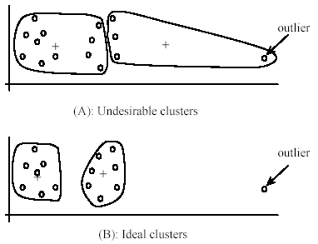
Comments on the K-Means Method
Strength:
  Simple: easy to understand and implement
  Efficient: linear in terms of # of data points, k and # of iterations.
Weakness:
  Applicable only to objects in a continuous n-dimensional space
  Need to specify k, the number of clusters, in advance
  Sensitive to noisy data and outliers (data points very far away from others)
  Not suitable to discover clusters with non-convex shapes

Slide 15
Variations of the K-Means Method
Most of the variants of the k-means which differ in
  Selection of the initial k clusters
  Distance calculations
  Strategies to calculate cluster means
Handling outliers: k-medoids
  Replacing means of clusters with medoids
  Using heuristics to update medoids
Handling categorical data: k-modes
  Replacing means of clusters with modes (most frequent points)
  Using new distance measures to deal with categorical data points

Slide 16
Outline
Introduction
Clustering:
  Partition-based method: K-means
  Density-based method: DBSCAN
Dimensionality Reduction:
  Linear transformation: PCA
  Nonlinear transformation: LLE
Deep Learning for Unsupervised Learning
16
16
Notes:
16

Slide 17
Density-based Clustering: Basic Concepts
Clusters are defined as areas of higher density of data points.
Two parameters:
  Eps: Maximum radius of the neighborhood
  MinPts: Minimum number of points in an Eps-neighborhood of that point to be considered “dense”
Neighborhood of p N_{Eps}(p): {q | d(p,q) ≤ Eps}
Directly density-reachable: A point p is directly density-reachable from a point q w.r.t. Eps, MinPts if
  neighboring: p belongs to N_{Eps}(q)
  core point: |N_{Eps} (q)| ≥ MinPts
Density-reachable: A point p is density-reachable from a point q if there is a chain of points p0, …, pn, p0 = q, pn = p such that pi+1 is directly density-reachable from pi.
p₁
p
p₂
q
Eps=1, MinPts=5

Slide 18
DBSCAN: Density-Based Spatial Clustering of Applications with Noise
Arbitrary select a point p
Retrieve all points density-reachable from p w.r.t. Eps and MinPts
If p is a core point, i.e., |N_{Eps} (q)| ≥ MinPts, a cluster is formed with all density-reachable points from p
If p is not a core point, no points are density-reachable from p and DBSCAN visits the next unvisited point
Continue the process until all of the points have been visited
Points don’t fall into any clusters are classified as outliers.

Slide 19
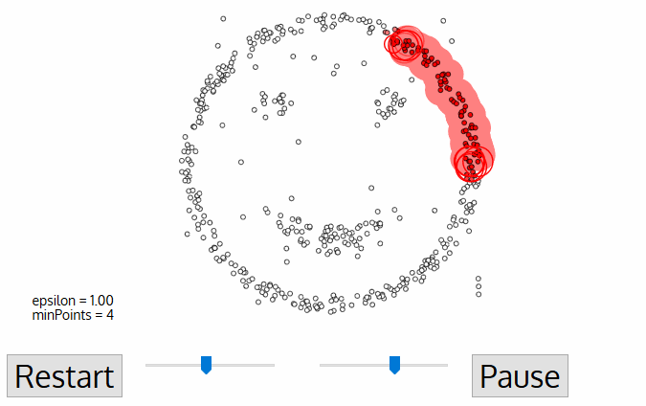
An Example of DBSCAN Clustering

Slide 20
Comments on DBSCAN Clustering
Strength:
  Doesn’t require the number of clusters as input.
  Discover clusters of arbitrary shape.
  Has a notion of noise, and can detect outliers.
Weakness:
  Can’t cluster datasets with large differences in density.
  Very sensitive to the parameters.
Related algorithms:
  OPTICS: Ankerst, et al (SIGMOD’99).
  DENCLUE: Hinneburg & D. Keim (KDD’98)
  CLIQUE: Agrawal, et al. (SIGMOD’98)

Slide 21
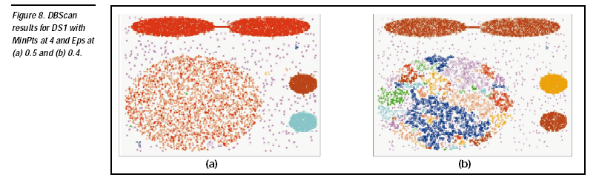

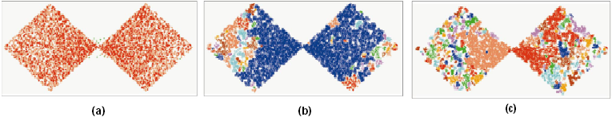
DBSCAN: Sensitive to Parameters

Slide 22
Outline
Introduction
Clustering:
  Partition-based method: K-means
  Density-based method: DBSCAN
Dimensionality Reduction:
  Linear transformation: PCA
  Nonlinear transformation: LLE
Deep Learning for Unsupervised Learning
22
22
Notes:
22

Slide 23
Dimensionality Reduction
Dimensionality reduction
  Map the n-dim data vector x into k-dim embedding y, where k << n, while preserving as much information as possible.
Motivation:
  Some features may be irrelevant to the task.
  Solve “Curse of Dimensionality”.
  Visualization and compression.
Different types of mapping
  Linear mapping: Map the data into a low-dimensional subspace. Typical methods: PCA, NMF, MDS
  Nonlinear mapping: Map the data into a low-dimensional manifold. Typical methods: LLE, SDE, t-SNE

Slide 24
Outline
Introduction
Clustering:
  Partition-based method: K-means
  Density-based method: DBSCAN
Dimensionality Reduction:
  Linear transformation: PCA
  Nonlinear transformation: LLE
Deep Learning for Unsupervised Learning
24
24
Notes:
24

Slide 25
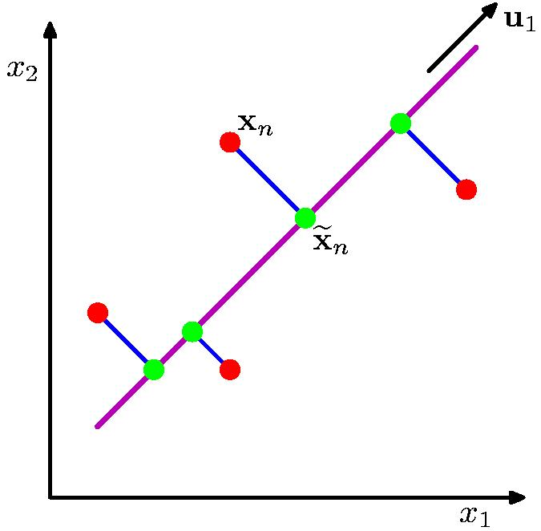
Principle Component Analysis
Rationale: Orthogonal projection of data onto a subspace that
  Maximizes the variance of projected data (purple line)
  Minimizes the mean square distance between original data points and projections (sum of blue lines)
Algorithm:
  Compute the principle axes as the top k eigenvectors of the covariance matrix of the data.
    First principal axis points to the direction of largest variance.
    Subsequent principle axis is orthogonal to the previous ones, and points in the directions of largest variance of the residual subspace
  Project the data points onto the principle axes, to get the principle components/embeddings.

Slide 26
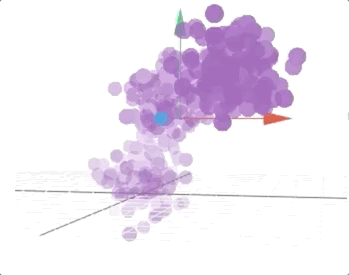
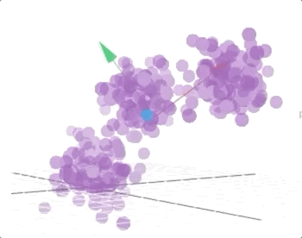
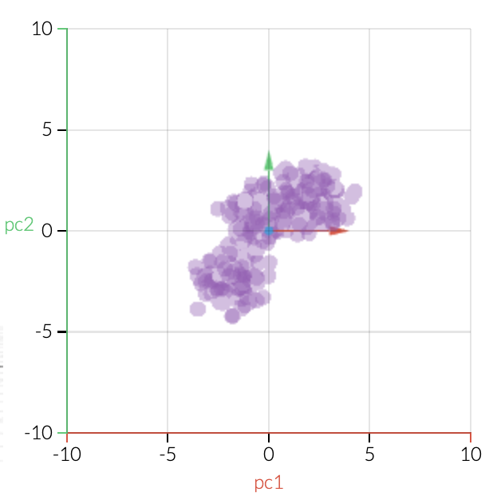
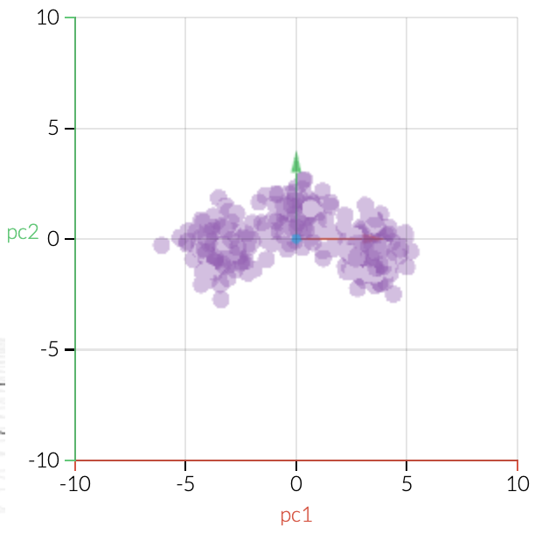
PCA: Example
Original 3D Data
Principle Components
Projection to original axes
Projection to principle axes

Slide 27
PCA for Face Recognition

Slide 28
Comments on PCA
Strength:
  Output orthogonal (uncorrelated) components.
  Remove noise in the data.
Weakness:
  High-computational cost.
  Can only capture linear variations.
  Sensitive to outliers.
Extensions：
  Sparse PCA: linear combination of a subset of dimensions.
  Nonlinear PCA: finding principle curves or manifolds.
  Robust PCA: PCA objective with regularizers.

Slide 29
Outline
Introduction
Clustering:
  Partition-based method: K-means
  Density-based method: DBSCAN
Dimensionality Reduction:
  Linear transformation: PCA
  Nonlinear transformation: LLE
Deep Learning for Unsupervised Learning
29
29
Notes:
29

Slide 30
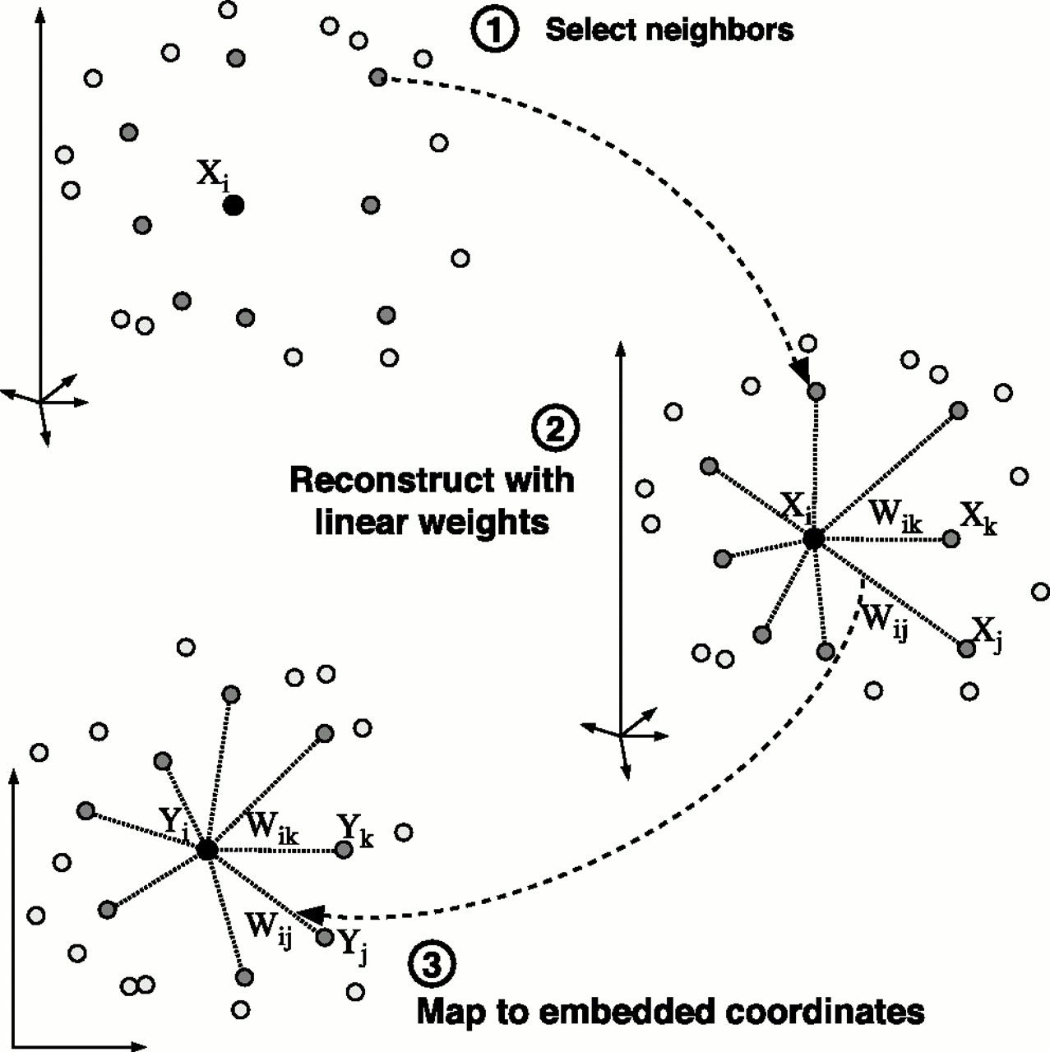
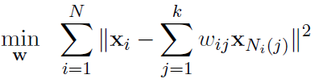
Locally Linear Embedding
Intuitive assumption:
  Each data point and its neighbors should lie on or close to a locally linear patch of the manifold, in original space and transformed space.
  In other words, each data point should be able to be linearly reconstructed by its neighbors.
Algorithm:
  Define neighbors for each point.
  Find the weights that best linearly reconstruct the point from its neighbors.
  Find the low-dimensional embedding that can best reconstruct the point with same weights.

Slide 31
LLE for Face Recognition

Slide 32
Comments on LLE
Strength:
  Accurately preserves local structure.
  Scalable as it’s a local method.
  Can capture non-linear manifolds.
Weakness:
  Fail to preserve global structure.
  Have difficulty on non-convex manifolds.
  Sensitive to outliers.
Extensions：
  Hessian LLE: better results but more computationally expensive.
  Modified LLE: also leads to robust projections without significant cost increase.

Slide 33
Outline
Introduction
Clustering:
  Partition-based method: K-means
  Density-based method: DBSCAN
Dimensionality Reduction:
  Linear transformation: PCA
  Nonlinear transformation: LLE
Deep Learning for Unsupervised Learning
33
33
Notes:
33

Slide 34
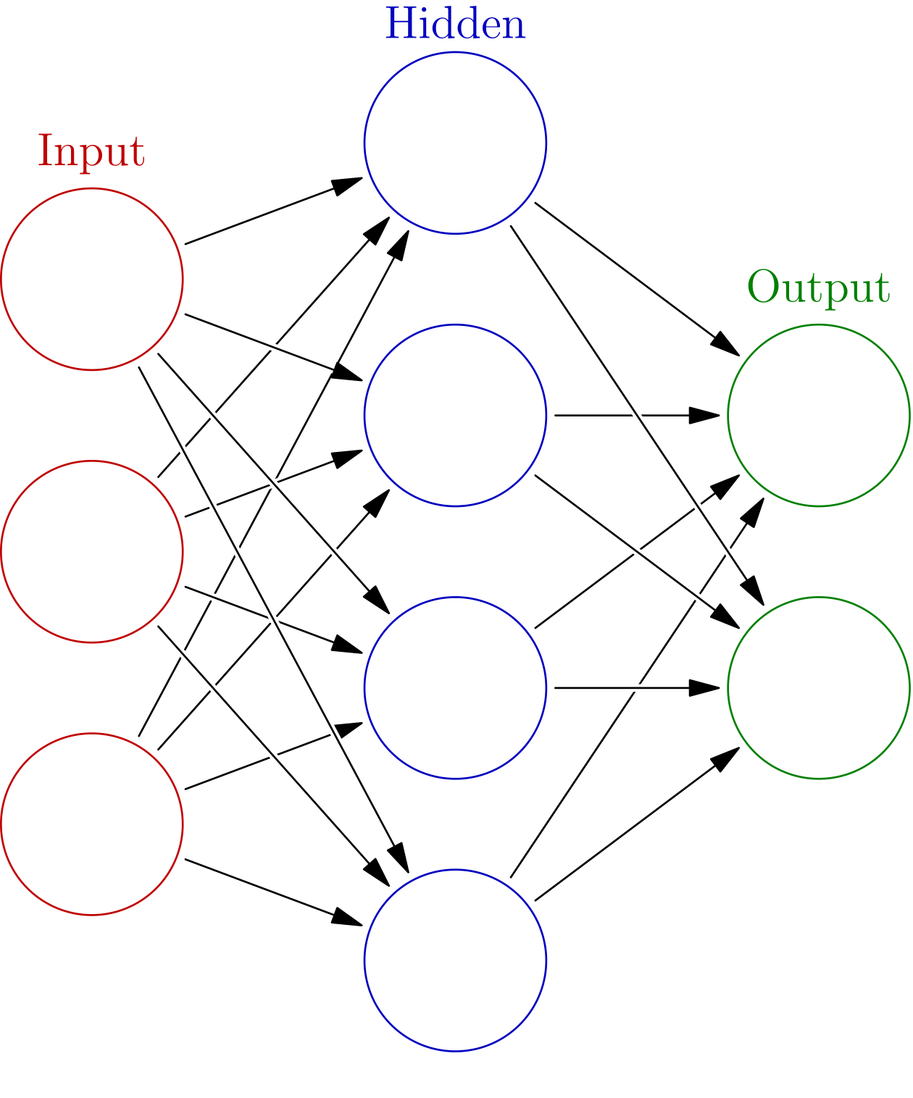
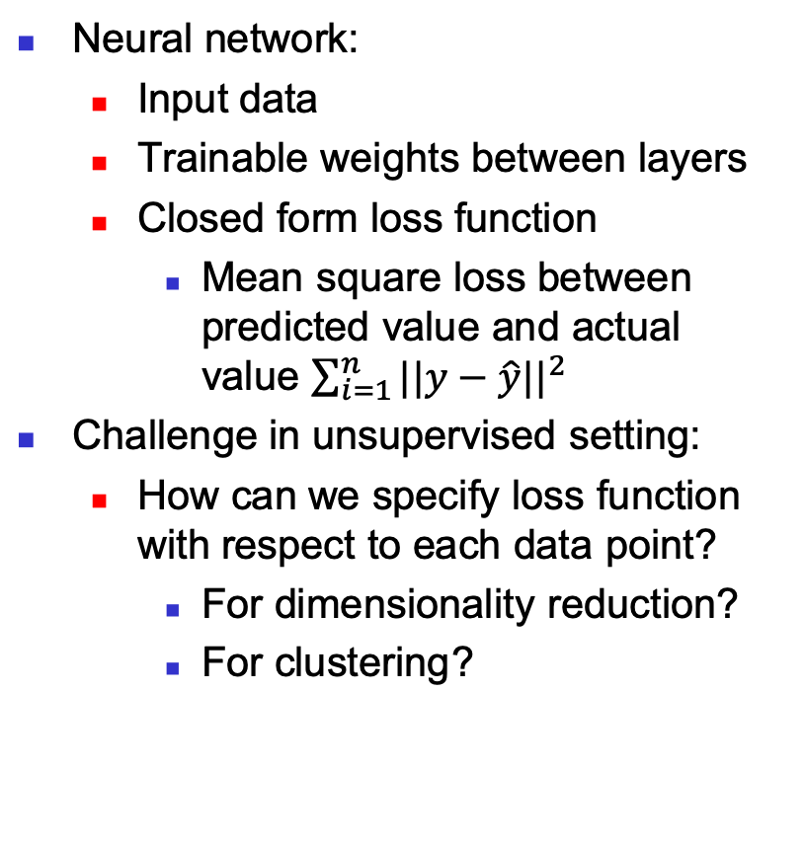
Neural Networks
Neural network:
  Input data
  Trainable weights between layers
  Closed form loss function
    Mean square loss between predicted value and actual value $\sum_{i=1}^{n}{{||y−\hat{y}||}^{2}}$
Challenge in unsupervised setting:
  How can we specify loss function with respect to each data point?
    For dimensionality reduction?
    For clustering?

Slide 35

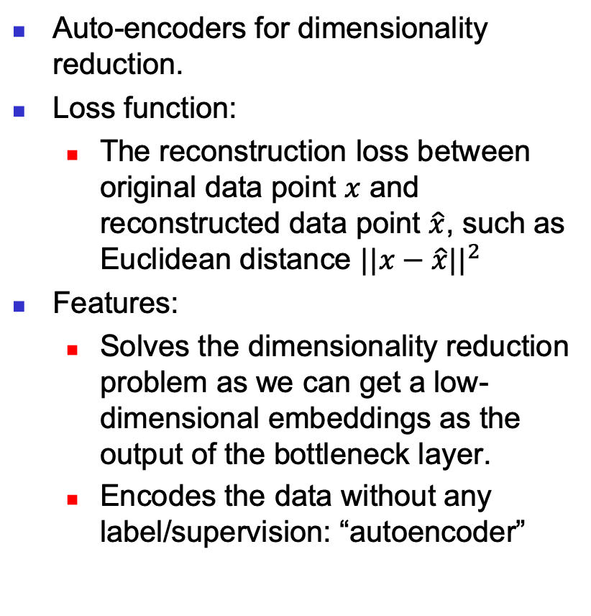
Auto-encoders
Auto-encoders for dimensionality reduction.
Loss function:
  The reconstruction loss between original data point $x$ and reconstructed data point $\hat{x}$, such as Euclidean distance ${||x−\hat{x}||}^{2}$
Features:
  Solves the dimensionality reduction problem as we can get a low-dimensional embeddings as the output of the bottleneck layer.
  Encodes the data without any label/supervision: “autoencoder”

Slide 36
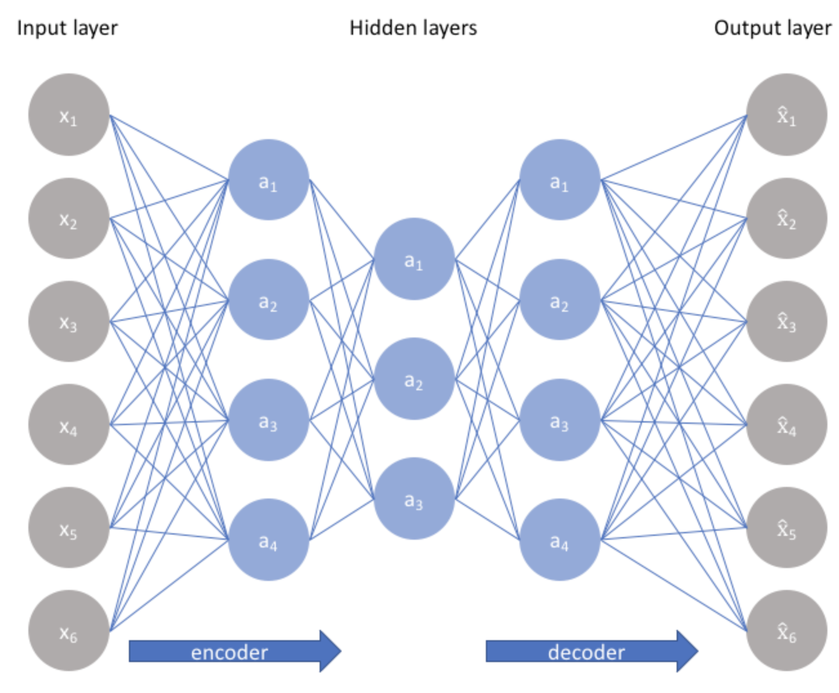
Stacked Auto-encoders
Stacked auto-encoders:
  More layer of encoders and decoders.
  More expressive power, harder to train and easier to overfit.

Slide 37
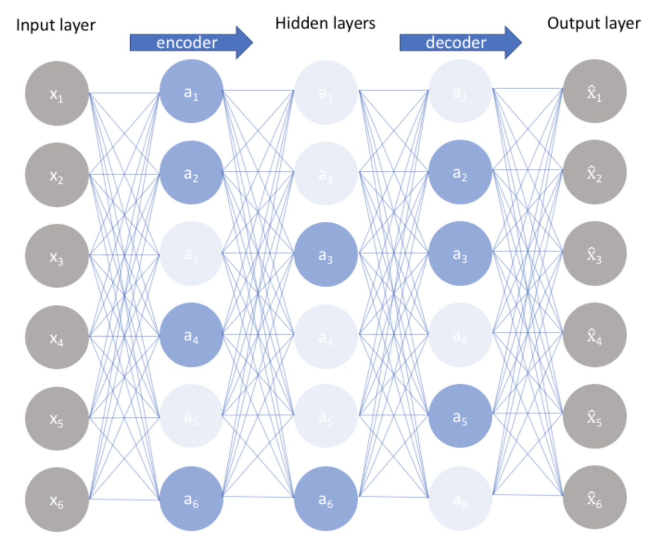
Sparse Auto-encoders
Sparse auto-encoders:
  By adding regularizers to penalize each active neurons, it can learn the number of dimensions for the embedding.

Slide 38
Sparse Auto-encoders
Sparse auto-encoders:
  By adding regularizers to penalize each active neurons, it can learn the number of dimensions for the embedding.

Slide 39
Auto-encoders: Images

Slide 40
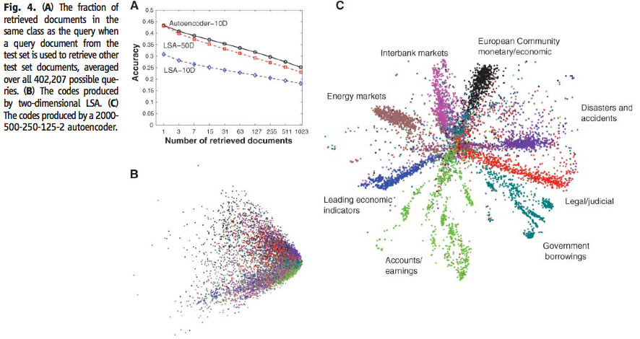
Auto-encoders: Documents
Notes:
LSA: latent semantic analysis, Like PCA, use SVD to do dimensionality reduction.

Slide 41
Comments on Auto-encoders
Strength:
  Preserves arbitrary non-linear structures.
  Amazing performance for images, documents, sounds, etc.
Weakness:
  Poor interpretability.
  Computationally expensive.
  Prone to overfitting.
Other extensions:
  Denoising autoencoders: manually add noise to input data to train the autoencoder to denoise, and thus more robust.
  Variational autoencoders: generative models that can even learn to synthetize fake data, e.g., fake images.

Slide 42
What about clustering?
Challenge remains for defining loss function.
Some recent attempts:
  Modified K-means loss (Yang et al., 2016a)
  Cluster assignment hardening (Xie et al., 2016)
  Balanced assignment loss (Dizaji et al., 2017)
  Locality-preserving loss (Huang et al., 2014)
  Group sparsity loss (Huang et al., 2014)
  Cluster classification loss (Hsu and Lin, 2017)
  Agglomerative clustering loss (Yang et al., 2016b)

Slide 43
References
Slides are based on
https://hanj.cs.illinois.edu/bk3/bk3_slides/10ClusBasic.ppt, https://hanj.cs.illinois.edu/bk3/bk3_slides/11ClusAdvanced.ppt
https://www.geeksforgeeks.org/clustering-in-machine-learning/
https://www.cs.uic.edu/~liub/teach/cs583-fall-05/CS583-unsupervised-learning.ppt
http://primo.ai/index.php?title=Density-Based_Spatial_Clustering_of_Applications_with_Noise_(DBSCAN)
https://web.stanford.edu/class/archive/anthsci/anthsci192/anthsci192.1064/handouts/11%20dimension%20reduction.ppt
http://www.cs.cmu.edu/~guestrin/Class/10701-S06/Handouts/recitations/recitation-pca_svd.ppt
https://www.cs.cmu.edu/~bapoczos/other_presentations/PCA_24_10_2009.pdf
http://setosa.io/ev/principal-component-analysis/
https://en.wikipedia.org/wiki/Principal_component_analysis
http://www.cse.cuhk.edu.hk/lyu/_media/dr.ppt
http://proceedings.mlr.press/v48/xieb16.pdf
https://medium.com/the-21st-century/machine-learning-a-strategy-to-learn-and-understand-chapter-3-9daaad4afc55
https://www.jeremyjordan.me/autoencoders/
http://www.martijn-onderwater.nl/wp-content/uploads/2009/10/2d-auto-encoder.jpg
https://arxiv.org/pdf/1801.07648.pdf

